Slide 1

Designing with the Quartus II Software

Slide 2

Objectives
Create a new project
Compile a design into an FPGA
Locate resulting compilation information
Assign design constraints (timing & pin)
Perform timing analysis & obtain results
Configure an FPGA

Slide 3
Class Agenda
Quartus II Projects
  Exercise 1
Design methodology
  Exercise 2
Compilation
  Exercise 3

Slide 4
Class Agenda
Timing analysis & assignments
  Classic Timing Analyzer
    Exercise 4 & 5
  TimeQuest Timing Analyzer
    Exercise 4 & 5
Simulation
Programming/configuration
  Exercise 6
Course will cover one of the two timing analyzers

Slide 5
Designing with the Quartus II Software
Introduction to Altera
& Altera Devices

Slide 6


The Programmable Solutions Company®
Programmable Logic Devices
Tools
  Quartus® II software
  SOPC Builder
  DSP Builder
  Nios® II IDE
Intellectual Property (IP)
  Signal processing
  Communications
  Embedded processors
    Nios II

Slide 7





Programmable Logic Families
Structured ASIC
  HardCopy® II & HardCopy Stratix devices
High & medium density FPGAs
  Stratix® II & Stratix devices
Low-cost FPGAs
  Cyclone® II & Cyclone device
FPGAs w/ clock data recovery
  Stratix II GX & Stratix GX devices
CPLDs
  MAX® II, MAX 7000 & MAX 3000 devices
Configuration devices
  Serial (EPCS) & enhanced (EPC)

Slide 8

Software & Development Tools
Quartus II software
  Stratix II & Stratix devices
  Stratix II GX & Stratix GX devices
  Cyclone II & Cyclone devices
  HardCopy II & HardCopy Stratix devices
  MAX II, MAX 7000S/AE/B, MAX 3000A devices
  Select older families
Quartus II Web Edition software
  Free version
  Not all features & devices included
    See www.altera.com for feature comparison
MAX+PLUS® II software
  All FLEX, ACEX, & MAX devices

Slide 9
Designing with the Quartus II Software
Quartus II Development System
Feature Overview

Slide 10
Quartus II Development System
Fully-integrated design tool
  Multiple design entry methods
  Logic synthesis
  Place & route
  Simulation
  Timing & power analysis
  Device programming

Slide 11
More Features
  MegaWizard® Plug-In & SOPC Builder design tools
  TimeQuest Timing Analyzer
  Incremental Compilation feature
  PowerPlay Power Analyzer tool
  NativeLink® 3rd-party EDA tool integration
  Debugging tools
    SignalTap® II logic analyzer
    Logic Analyzer Interface
    SignalProbe™ feature
    In-System Memory Content Editor
  Windows, Solaris, HPUX, & Linux support
  Node-locked & network licensing options

Slide 12
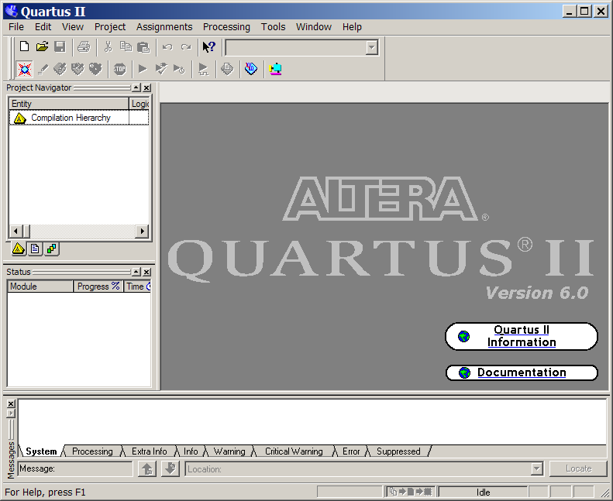
Operating Environment
Project Navigator
Status window
Message window

Slide 13
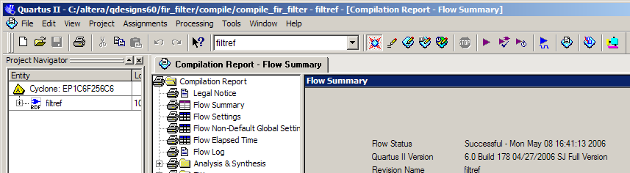
Main Toolbar
Execution controls
Window & new file buttons
Dynamic menus
Compiler report
Floorplan
To reset views:
Tools ⇒ Customize ⇒ Toolbars ⇒ Reset All
Restart

Slide 14
Designing with the Quartus II Software
Design Methodology

Slide 15
Typical PLD Design Flow
Design Specification
Design entry/RTL coding
- Behavioral or structural description of design
RTL simulation
- Functional simulation
- Verify logic model & data flow
(no timing delays)
LE
M512
Synthesis
- Translate design into device specific primitives
- Optimization to meet required area & performance constraints
M4K
I/O
Place & route
- Map primitives to specific locations inside
Target technology with reference to area &
performance constraints
- Specify routing resources to be used

Slide 16

Typical PLD Design Flow
t_{clk}
Timing analysis
- Verify performance specifications were met
- Static timing analysis
Gate level simulation
- Timing simulation
- Verify design will work in target technology
PC board simulation & test
- Simulate board design
- Program & test device on board

Slide 17
Designing with the Quartus II Software
Quartus II Projects

Slide 18
Quartus II Projects
Description
  Collection of related design files & libraries
  Must have a designated top-level entity
  Target a single device
  Store settings in Quartus II Settings File (.QSF)
Create new projects with New Project Wizard
  Can be created using Tcl scripts

Slide 19
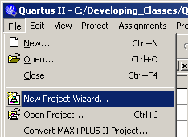
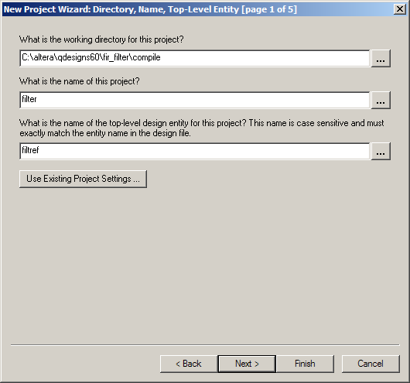
New Project Wizard
File menu
Select working directory
Name of project can be any name; recommend using top-level file name
Create a new project based on an existing project & settings
Top-level entity does not need to be the same name as top-level file name

Slide 20
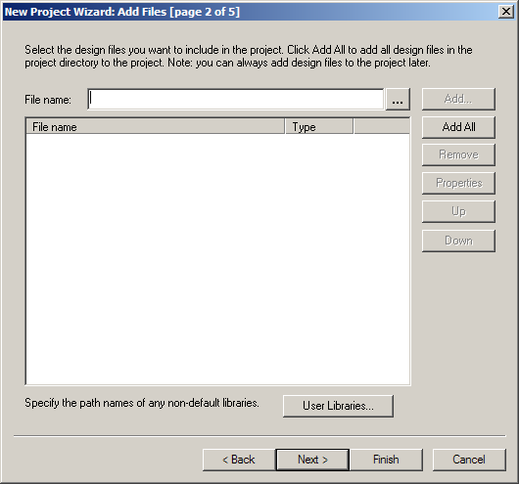
Add Files
Add design files
Graphic (.BDF, .GDF)
AHDL
VHDL
Verilog
EDIF
Notes:
Files in project directory do not need to be added
Add top level file if filename & entity name are not the same
Add user library pathnames
User libraries
MegaCore®/AMPPSM libraries
Pre-compiled VHDL packages

Slide 21
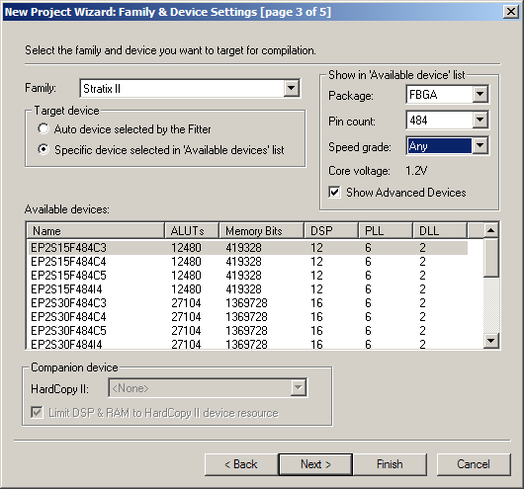
Device Selection
Choose device family
Choose specific part number from list or let software choose smallest fastest device based on filter criteria

Slide 22
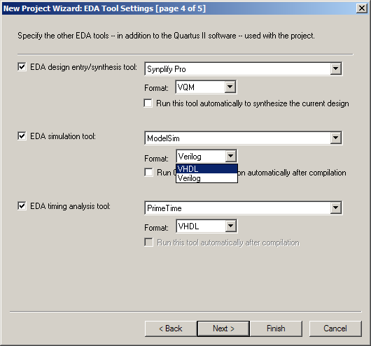
EDA Tool Settings
Choose EDA tools & file formats
Add or change settings later

Slide 23
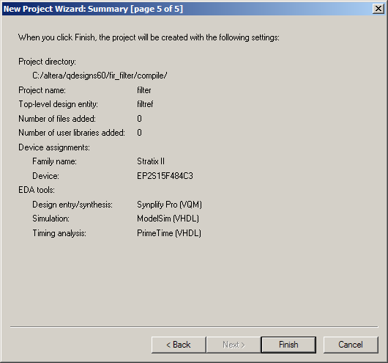
Done!
Review results & click on finish

Slide 24
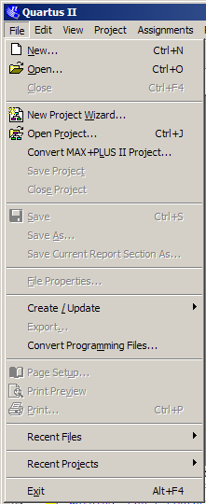
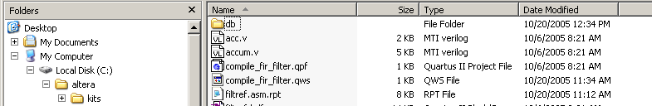

Opening a Project
Double-clicking the .QPF file will auto launch Quartus II software
OR
File ⇒ Open Project
OR
Select from most recent projects list

Slide 25
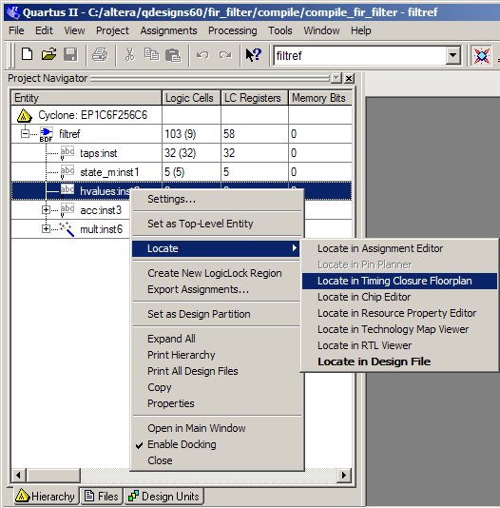
Project Navigator – Hierarchy Tab
Displays project hierarchy after project is analyzed
Uses
  Set top-level entity
  Set incremental design partition
  Make entity-level assignments
  Locate in design file or viewers/floorplans
  View resource usage
Select & right-click

Slide 26
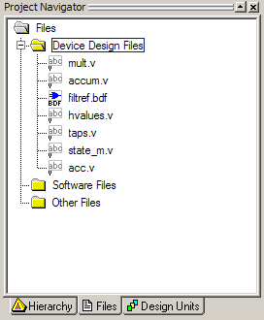
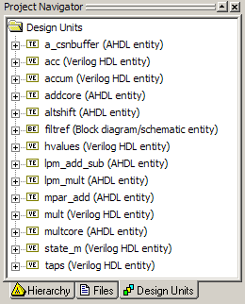
Files & Design Units Tabs
Files tab
  Shows files explicitly added to project
  Uses
    Open files
    Remove files from project
    Set new top-level entity
    Specify VHDL library
    Select file-specific synthesis tool
Design Units tab
  Displays design unit & type
    VHDL entity
    VHDL architecture
    Verilog module
    AHDL subdesign
    Block diagram filename
  Displays file which instantiates design unit

Slide 27
Quartus II Project File (.QPF)
Quartus II software version
Time stamp
Active revision
COMPILE_FILTER.QPF
QUARTUS_VERSION = “6.0"
DATE = “08:37:10 May 05, 2006"
# Active Revisions
PROJECT_REVISION = "filtref“
PROJECT_REVISION = "filtref_new"
Note: Constraint files discussed later.

Slide 28
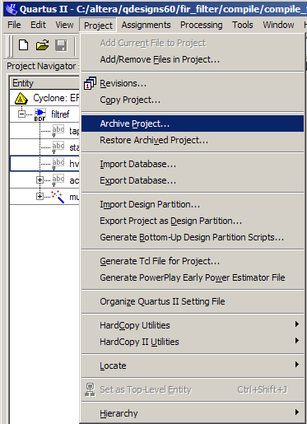
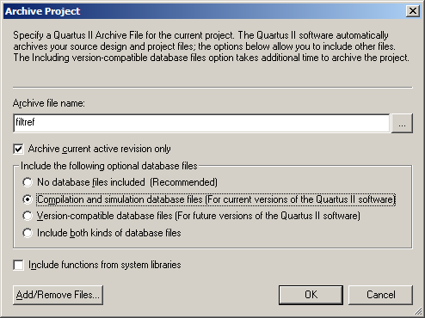
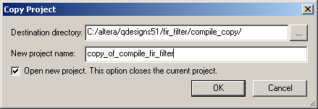
Project Management
Project archive & restore
  Creates compressed Quartus II Archive File (.QAR)
  Creates archive activity log (.QARLOG)
Project copy
  Copies & save duplicate of project in new directory
    Project file (.QPF)
    Design files
    Settings files
Archive Project
Copy Project

Slide 29
Please go to Exercise 1 in the Exercise Manual

Slide 30
Exercise Summary
Created a new project using the New Project Wizard

Slide 31
Projects Entry Summary
Projects necessary for design processing
Use New Project Wizard to create new projects
Use Project Navigator to study file & entity relationships within project

Slide 32
Project Support Resources
“Quartus II Project Management” chapter in Quartus II Handbook

Slide 33
Designing with the Quartus II Software
Design Entry

Slide 34
Design Entry Methods
Quartus II software
  Text Editor
    AHDL
    VHDL
    Verilog
  Schematic Editor
    Block diagram file
    Graphic design file
  Memory Editor
    HEX
    MIF
3rd-party EDA tools
  EDIF 2 0 0
  Verilog/VHDL
  Verilog Quartus Mapping (.VQM)
Mixing & matching design files allowed
Top-Level File
Top-level design files can be schematic, HDL or 3rd-Party netlist file
.bdf
.gdf
.bsf
.tdf
.vhd
.v
.edf
.edif
.v, vlg,
.vhd, .VHDL, vqm
Block
file
Symbol
file
Text
file
Text
file
Text
file
Text
file
Text
file
Generated within Quartus II software
Imported from 3rd-Party EDA tools

Slide 35
Text Design Entry
Quartus II Text Editor features
  Line numbering in the HDL text files
  Preview of HDL templates
  Syntax coloring
  When editing a text file, asterisk (*) appears next to the filename
    Asterisk disappears after saving the file
Enter text description
  AHDL (.TDF)
  VHDL (.VHD, .VHDL)
  Verilog (.V, .VLG, .Verilog, .VH)

Slide 36
Verilog & VHDL
VHDL- VHSIC hardware description language
  IEEE Std 1076 (1987 & 1993) supported
  IEEE Std 1076.3 (1997) synthesis packages supported
Verilog
  IEEE Std 1364 (1995 & 2001) & 1800 (SystemVerilog) supported
Create in Quartus II text editor or any standard text editor
Use Quartus II Integrated Synthesis to synthesize
View supported commands in on-line help
Learn more about HDL in Altera
Customer Training Classes

Slide 37
AHDL
Altera hardware description language
  High-level hardware behavior description language
  Used in Altera megafunctions
  Uses boolean equations, arithmetic operators, truth tables, conditional statements, etc.
Create in Quartus II text editor or any standard text editor

Slide 38
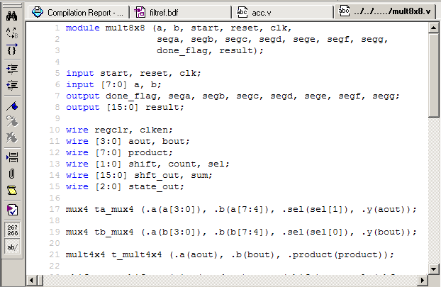
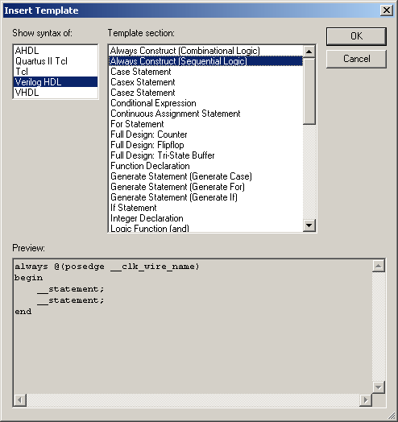
HDL Templates
2) Select language
3) Select template section
1) Click on toolbar shortcut or Insert Template (Edit Menu)
4) Preview window display section

Slide 39
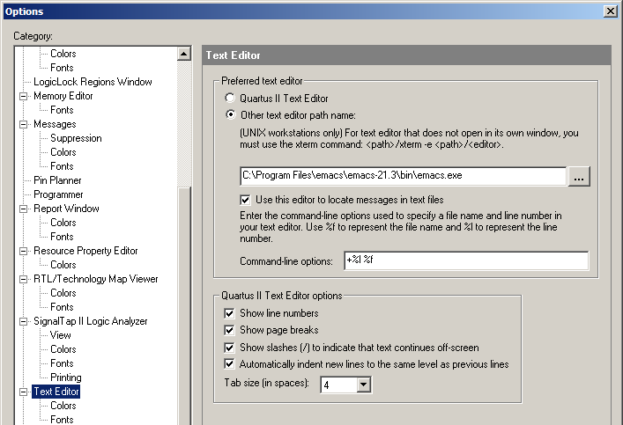
Using Own Text Editor
Enter path to preferred text editor executable
Tools menu ⇒ Options
Enter text editor command-line options used to specify file name and line number

Slide 40
Schematic Design Entry
Full-featured schematic design capability
Schematic Editor uses
  Create simple test designs to understand the functionality of megafunctions
    PLL, LVDS I/O, memory, etc…
  Create top-level schematic for easy viewing & connection
    Can convert Block Diagram File (.BDF) to HDL
Note: Please see the Appendix for a more detailed discussion of the Block Diagram Editor and schematic entry.

Slide 41
Megafunctions
Pre-made design blocks
  Ex. Multiply-accumulate, PLL, double-data rate (DDR)
Benefits
  Free & installed with Quartus II software
  Accelerate design entry
  Pre-optimized for Altera device architecture
  Add flexibility
Two types
  Altera megafunctions (begin with “ALT”)
  Library of parameterized modules (LPMs)
    Industry standard logic functions

Slide 42

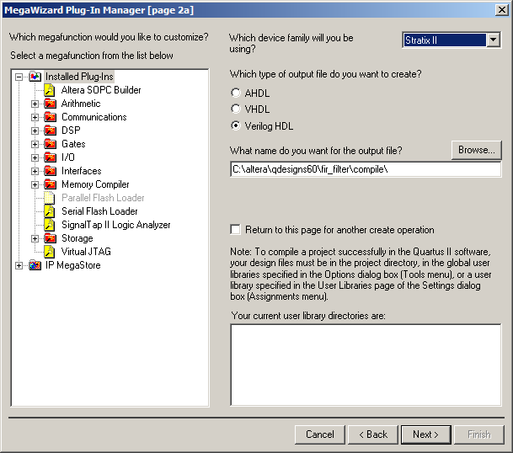
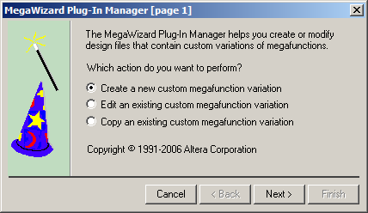
MegaWizard Plug-in Manager
Eases implementation of megafunctions & IP
Tools ⇒ MegaWizard Plug-In Manager

Slide 43
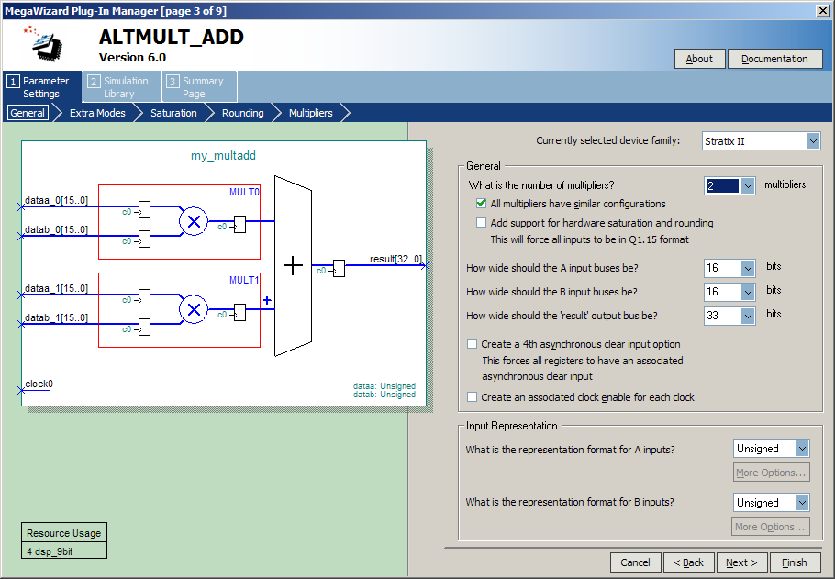
MegaWizard Plug-In Example
Multiply-Add megafunction
Locate Documentation in Quartus II online help or the Web
Three step process to configure megafunction
Resource Usage

Slide 44
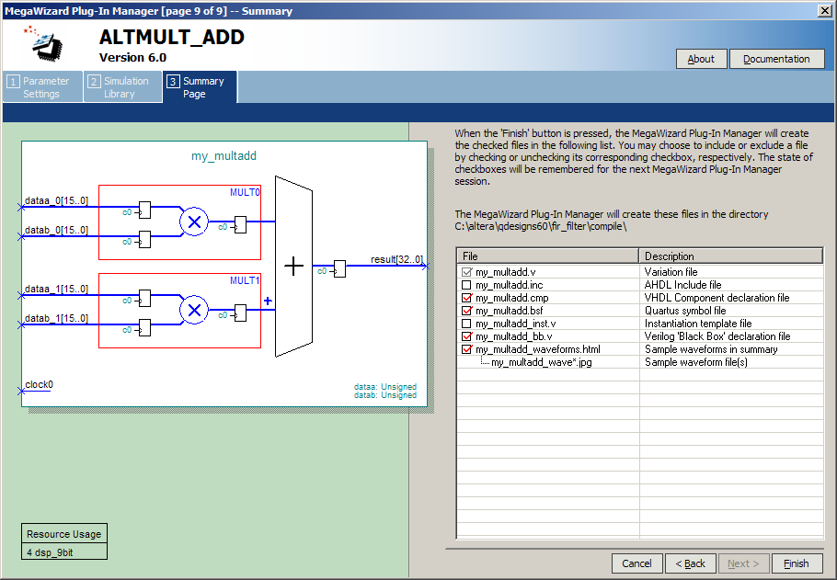
MegaWizard Output File Selection
Default
  HDL wrapper file
Selectable
  HDL instantiation template
  VHDL component declaration (CMP)
  Quartus II symbol file (BSF)
  Verilog black box

Slide 45
Behavioral Waveforms
HTML file generated by MegaWizard Plug-In Manager
Description of megafunction functionality
  Reviews selected parameters
  Describes read & write operations
Supported megafunctions
  Subset of memory
  Subset of arithmetic
  PLL

Slide 46
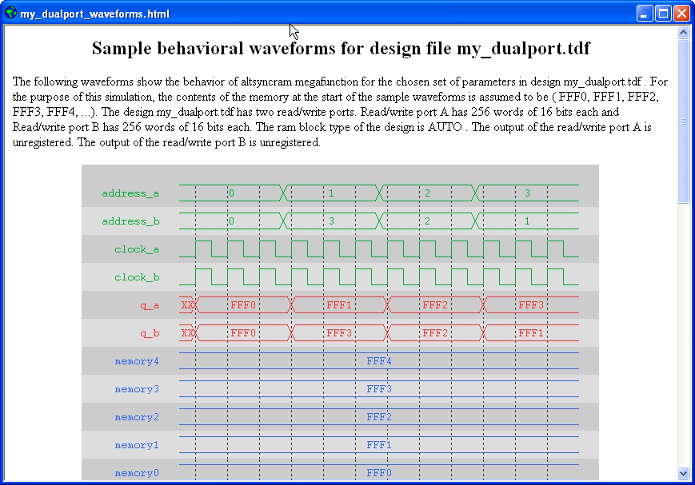
Example Waveform

Slide 47
Memory Editor
Create or edit memory initialization files in Intel HEX (.HEX) or Altera file format (.MIF)
Design entry
  Use to initialize your memory block (ex. RAM, ROM) during power-up
Simulation
  Use to initialize memory blocks before simulation or after breakpoints

Slide 48
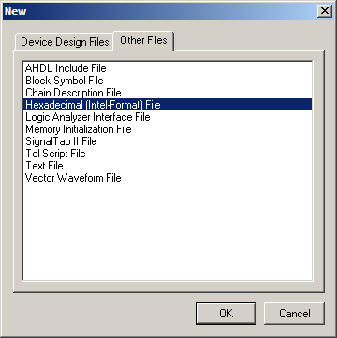
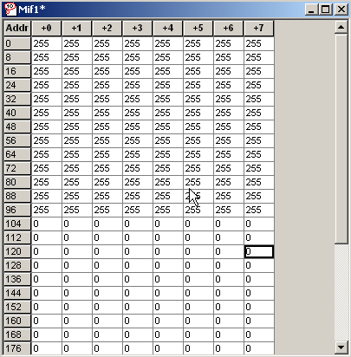
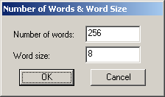
Create Memory Initialization File
File ⇒ New ⇒ Other Files tab
3) Memory space graphic opens
1) HEX format or
MIF format
2) Select Memory Size

Slide 49
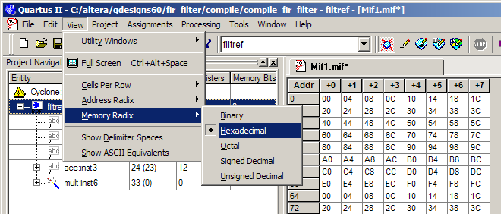
Change Options
View options of memory editor
  View ⇒ select from available options

Slide 50
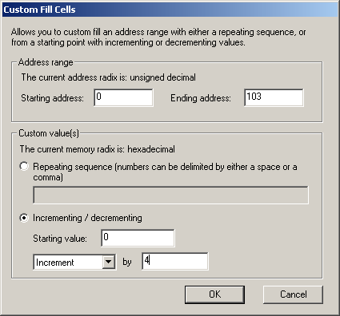
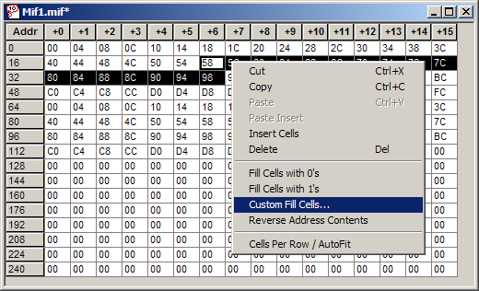
Edit Contents
Select address location & type in a value
OR
Select the address & right-click to select fill option from menu
OR
Copy & paste from spreadsheet
Edit contents of memory file
Save memory file as .HEX or .MIF file
Specify custom cell fill
Repeating sequence
Increment/decrement count

Slide 51
Memory Size Wizard
Need to edit size of memory file?
Use the memory size wizard (edit menu)
  Edit word size
  Edit number of words
  Specify how to handle word size change
    Increasing word size
      Pad words
      Combine words
    Decreasing word size
      Truncate words from left
      Truncate words from right

Slide 52
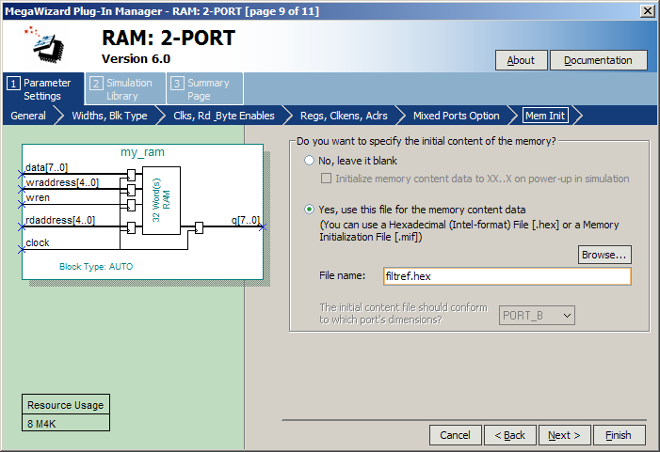
Using Memory File In Design
Specify MIF or HEX file in MegaWizard Plug-In
May also specify MIF or HEX file in HDL using the ram_init_file attribute

Slide 53
EDA Interfaces Introduction
Interface with industry-standard EDA tools that generate a netlist file
  EDIF 2 0 0
  VHDL
  Verilog
NativeLink interface provides seamless integration with 3rd-party EDA software tools
  Tools pass information/commands in background
  Designers can complete entire design in one tool

Slide 54
NativeLink Interface Files
Comprised of two components
  External files
    WYSIWYG (what you see is what you get) ATOM netlist files (EDIF, Verilog, VHDL)
    Cross reference files (ex. XRF)
    Timing files (ex. SDO)
  Application programming interface (API)
    Pre-defined interface of commands/functions
API
EDA Partners
External
Files

Slide 55
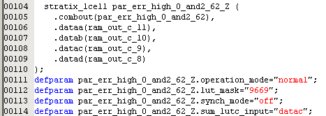
WYSIWYG ATOM Primitives
Set of design primitives that support WYSIWYG compilation
Provide direct control of how a design is technology-mapped to a specific target device
Allow synthesis vendors to provide an optimal realization of a design for each architecture
Synplify.VQM

Slide 56
WYSIWYG Compilation Flow
EDA
Synthesis
Partner
Notes:
Logic options in Quartus II software that control synthesis can no longer be used.
Inferred megafunctions must still be synthesized in Quartus II software
Logic
synthesis
Netlist Extraction
Database Builder
Synthesis
Place & Route
EDF VQM
Design input files
with
WYSIWYG primitives

Slide 57
Three EDA Design Flows
Quartus II software-driven flow
  User launches 3rd-party EDA tools in the background
  Messages appear in Quartus II message window
Vendor-driven flow
  User runs place & route in the background from the 3^{rd-}party EDA tool
File-based flow
  Each tool ran separately
  Files are manually transferred between tools

Slide 58
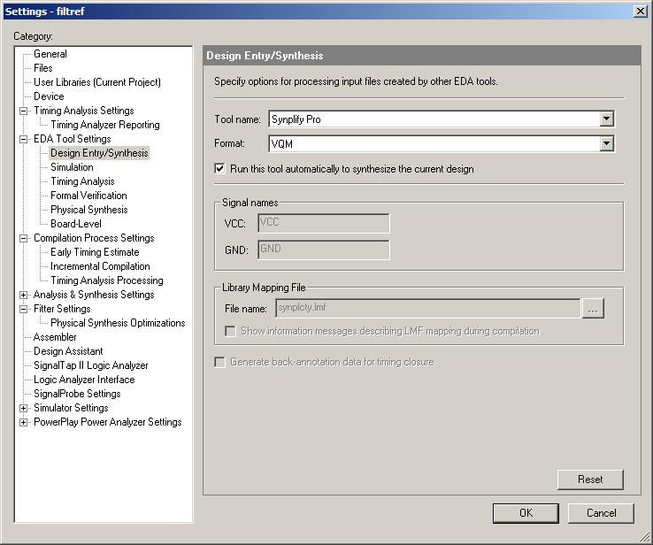
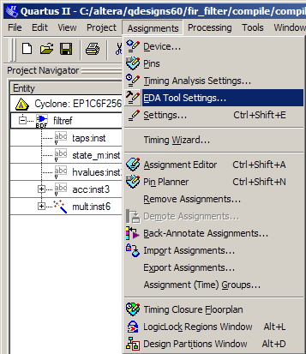
Enabling 3rd–Party EDA Tools
Assignments ⇒ EDA Tool Settings
Check “Run …” button to launch EDA tool in background
Leave unchecked for file-based flow

Slide 59
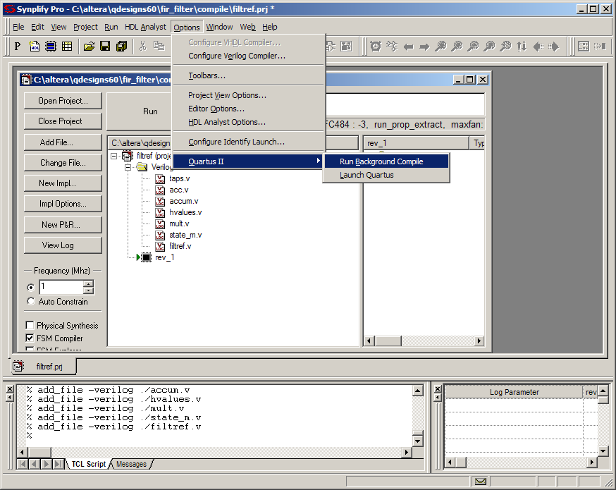
EDA Driven Flow
Run Quartus II fitter in the background by selecting run background compile or separately launch Quartus II software

Slide 60
3rd-Party Synthesis Tool Support
Mentor Graphics®
  LeonardoSpectrum™ synthesis tool
  Precision RTL Synthesis
Synopsys
  Design Compiler FPGA
  FPGA Compiler II
Synplicity
  Synplify
  Synplify Pro

Slide 61
Please go to Exercise 2 in the Exercise Manual

Slide 62
Exercise Summary
Generated logic using MegaWizard Plug-In Manager
Initialized memory contents with MIF file
Performed analysis & elaboration to check the file

Slide 63
Design Entry Summary
Multiple design entry methods
  Text (Verilog, VHDL, AHDL)
  3rd-party netlist (VQM, EDF)
  Schematic
Memory Editor
MegaWizard Plug-In Manager
EDA tool flows

Slide 64
Design Entry Support Resources
Quartus II Handbook chapters
  “Design Recommendations for Altera Devices”
  “Recommended HDL Coding Styles”
  3rd-Party EDA tool chapters (Volume 1, Section 3)
Training courses & demonstrations
  VHDL & Verilog Basics (online courses)
  Introduction & Advanced HDL courses

Slide 65
Designing with the Quartus II Software
Compilation

Slide 66
Compilation
Synthesis
Fitting
Generating output
  Timing analysis output netlist
  Simulation output netlists
  Programming/configuration output files

Slide 67
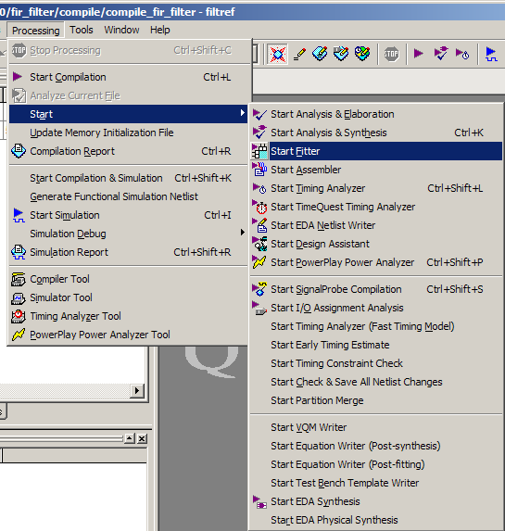
Processing Options
Start Compilation
  Performs full compilation
Start Analysis & Elaboration
  Checks syntax & builds database only
  Performs initial synthesis
Start Analysis & Synthesis
  Synthesizes & optimizes code
Start Fitter
  Places & routes design
  Generates output netlists
Start Assembler
Start Timing Analysis
Start I/O Assignment Analysis
Start Design Assistant

Slide 68
Compilation Design Flows
Standard flow
  Design compiled as a whole
  Global optimizations performed
Incremental flow
  User controls how & when pre-selected parts of design are compiled
  Benefits
    Decrease compilation time
    Maintain & improve compilation results
  Two types
    Incremental synthesis
    Incremental fitting

Slide 69
Incremental Compilation Concept
TOP
A:inst1
Choose to reuse post-synthesis or post-fit netlist
B:inst2
TOP
+
A:inst1
=
A
B’:inst2
B:inst2
+
B
Only specified portions of logic that have changed are re-synthesized or re-fitted
B’

Slide 70
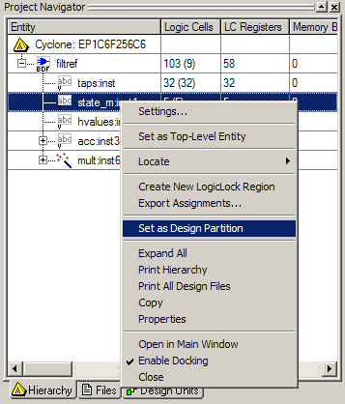
Example User Flow
Run analysis & elaboration
Mark partitions using Project Navigator
Assign each partition to physical location in FPGA
Compile design
Choose netlist type for each partition
Make design changes or change settings for any partition
Perform incremental compilation
Right-click on hierarchical level in Project Navigator
Note:
For more details on using incremental compilation, please attend the course “Accelerating Design Cycles using the Quartus II Software” or watch the web-recording “Introduction to Incremental Compilation”

Slide 71
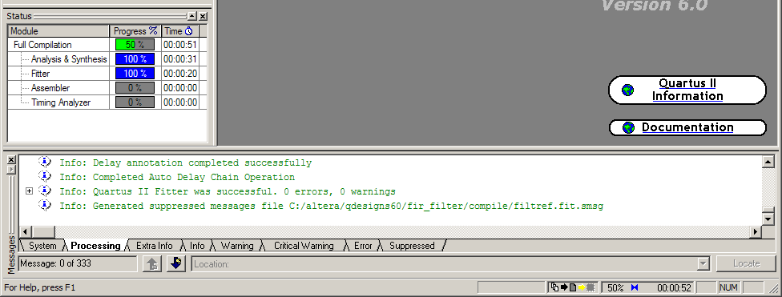
Status & Message Windows
Status bars scroll to indicate progress during compilation
Message window displays informational,
warning & error messages

Slide 72
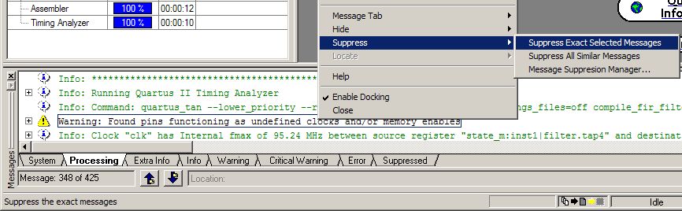
Message Suppression
Hides messages from current & future compiles
  Ex. Known synthesis warning message already investigated
Displays suppressed messages on different tab in message window
Stores suppression rules in <revision_name>.SRF file
Choose Suppress
Right-Click on Message
Suppress Exact or Similar Messages

Slide 73
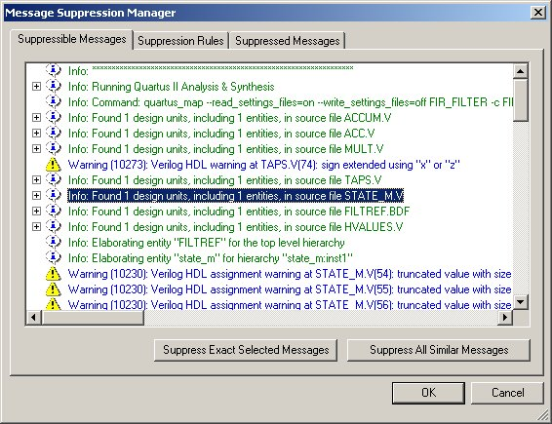
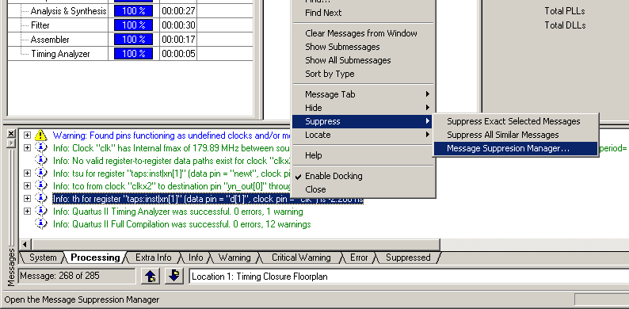
Message Suppression Manager Tool
Use to
  View all suppressible messages
  View/add/remove suppression rules
  View messages suppressed for current & future compiles

Slide 74
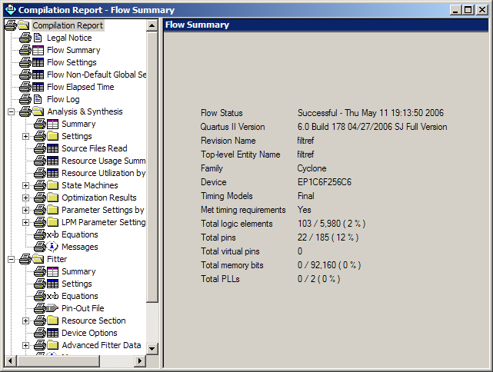
Compilation Report
Contains all processing information
Resource usage
Timing analysis
Pin-out file
Messages

Slide 75
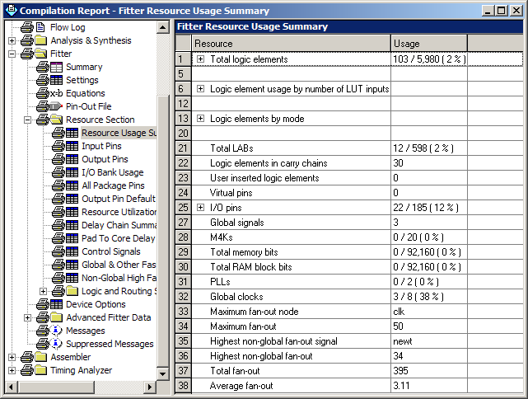
Resource Usage
Several tables in Resource Section detail how much of FPGA resources used

Slide 76
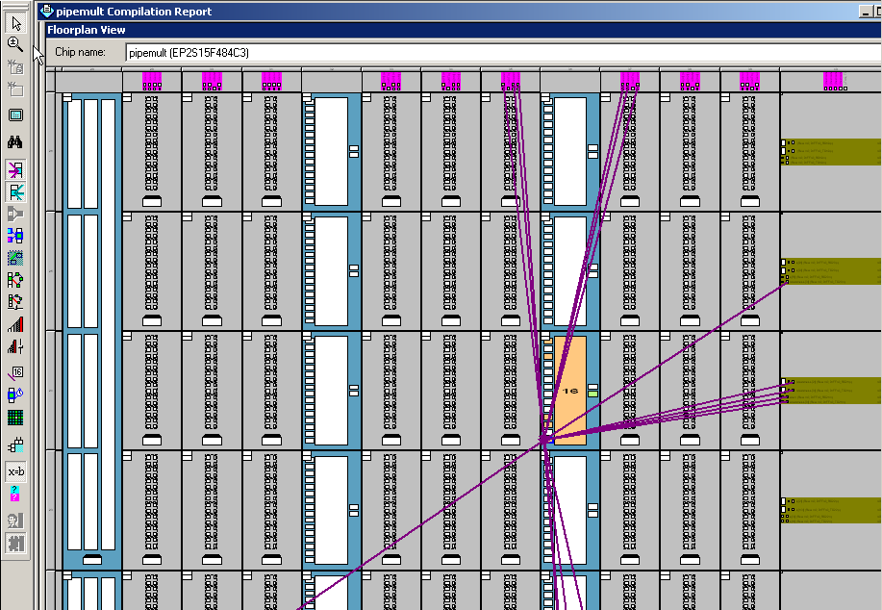
Timing Closure Floorplan
Assignments Menu
Editable view of target technology used to:
View placement
View connectivity
Make placement assignments

Slide 77
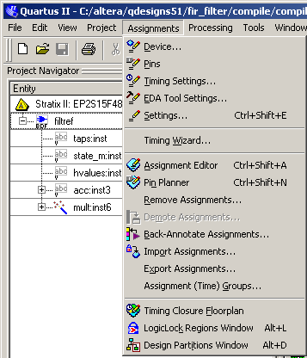
Synthesis & Fitting Control
Controlled using two methods
  Settings
    Project-wide switches
  Assignments (i.e. logic options; constraints)
    Individual entity/node controls
Accessed using Assignments menu
Stored in QSF file

Slide 78
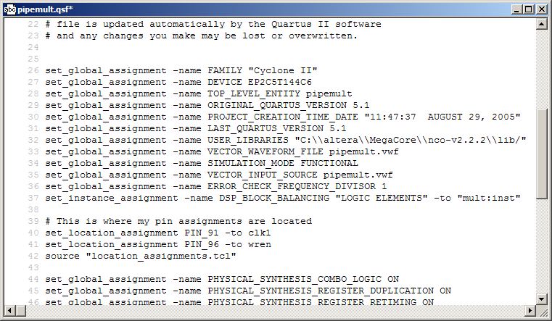
Quartus II Settings File (QSF)
Stores all settings & assignments
Uses Tcl syntax
Can be edited by user
See “Quartus II Settings File Reference Manual” for more details on QSF assignments & syntax
Reorganize QSF based on categories (Project menu)
Add user comments (#) & white spaces
NEW assignments added to end of file
Source other TCL/QSF files to organize assignments
Note: See Appendix for more notes on using QSF file.

Slide 79
Constraint File Priority
QSF
Quartus II Defaults File (QDF) located in project directory
QDF located in \win directory of software install
QDF
  Stores project defaults
  Name: assignment_defaults.qdf

Slide 80
Settings
Examples
  Device selection
  Synthesis optimization
  Fitter settings
  Physical synthesis
  Design Assistant
Located in Settings dialog box (assignments menu)

Slide 81
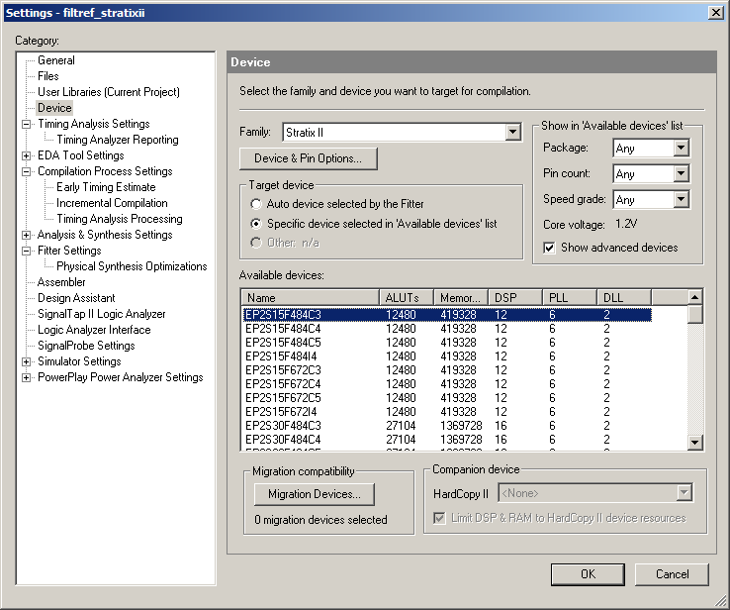
Settings Dialog Box
Change settings
Top-level entity
Target device
Add/remove files
Libraries
VHDL ‘87, ‘93?
Verilog ‘95, ‘01?
EDA tool settings
Timing settings
Compiler settings
Synthesis settings
Fitter settings
Simulator settings

Slide 82
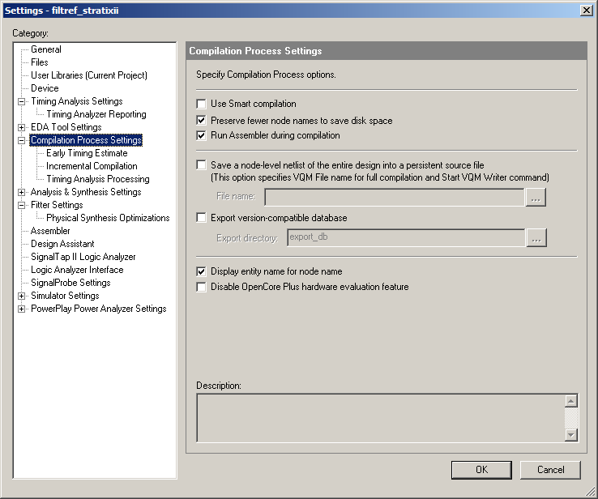
Compilation Process
1
2
3
Smart compilation⁽¹⁾
  Skips entire compiler modules when not required (i.e. elaboration, synthesis, etc.)
  Saves compiler time
  Uses more disk space
Preserve fewer node names⁽²⁾
  Disable for VHDL/verilog synthesis
Generate version-compatible database⁽³⁾

Slide 83
Version-Compatible Database
Recommended
Exports a database that can be opened directly in another software version
  Import database into new version
Two methods to create
  Settings dialog box
  Project menu
Analyze Previously Compiled Projects Using Updated Timing Models

Slide 84
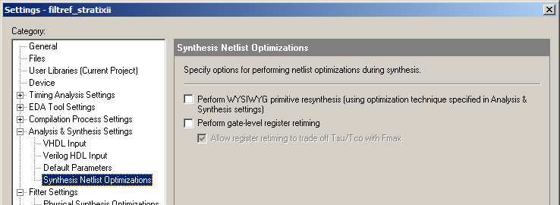
Synthesis Netlist Optimizations
Further optimize netlists during synthesis
Types
  WYSIWYG primitive resynthesis
  Gate-level register retiming
Created/modified nodes noted in Compilation Report

Slide 85
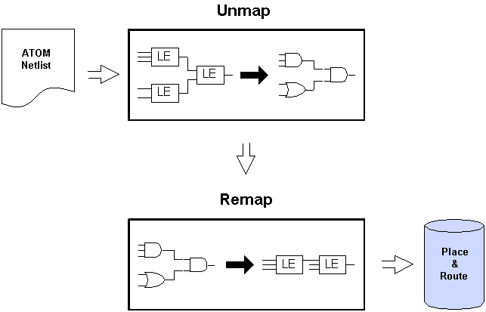
WYSIWYG Primitive Resynthesis
Unmaps 3rd-party atom netlist back to gates & then remaps to Altera primitives
  Unavailable when using integrated synthesis
Considerations
  Node names may change
  3rd-party synthesis attributes may be lost
    Preserve/keep
  Some registers may be synthesized away

Slide 86

Gate-Level Register Retiming
Moves registers across combinatorial logic to balance timing
Trades between critical & non-critical paths
Makes changes at gate level

Slide 87

Fitter Settings
Compilation speed/fitter effort
  Standard fit
    Highest effort
    Longest compile time
  Fast fit
    Faster compile but possibly lesser design performance
  Auto fit
    Compile stops after meeting timing
    Conserves CPU time
    Will mimic standard fit for hard-to-fit designs
    Default for new designs
  One fitting attempt
Notes:
Compilation Speed : Reduce compilation time, may also reduce performance

Slide 88

Physical Synthesis
Re-synthesis based on fitter output
  Makes incremental changes that improve results for a given placement
  Compensates for routing delays from fitter

Slide 89
Physical Synthesis
Types
  Combinational logic
  Asynchronous signal pipelining
  Register duplication
  Register retiming
Effort
  Trades performance vs. compile time
  Normal, extra or fast
New or modified nodes appear in Compilation Report

Slide 90
Combinational Logic
Swaps look-up table (LUT) ports within les to reduce critical path LEs
a
LUT
a
LUT
b - critical
e
c
c
d
d
e
LUT
b
LUT
f
f
g
g

Slide 91
Asynchronous Signal Pipelining
Adds pipeline registers to asynchronous clear or load signals in very fast clock domains
Added pipeline stage
aclr
aclr
D
Q
aclr
aclr
aclr
D
Q
D
Q
aclr
aclr
Global clock delay
D
Q

Slide 92
Duplication
High fan-out registers or combinatorial logic duplicated & placed to reduce delay
N

Slide 93

Design Assistant
Checks for potential design issues
  Clocks
  Reset
  Synchronous design structures
  Timing closure
  Asynchronous clock domain data transfers
If enabled, executes automatically during compilation
May also run separately from Processing menu

Slide 94
Assignments (Logic Options)
Assignment Editor
Example assignments
I/O assignments & analysis
Perform analysis & elaboration before obtaining hierarchy & node information

Slide 95

Assignment Editor (AE)
Provides spreadsheet assignment entry & display
  Can copy & paste from clipboard
Assignments Menu
Enable/disable individual assignments
Sort on columns
Assignment Editor toolbar
Customizable columns

Slide 96

Cross-Probing to Assignment Editor
Virtually all windows & tools cross-probe (locate) to Asssignment Editor
Examples
  Project Navigator
  Message window
  Compilation Report
  Design files
To invoke Assignment Editor:
Highlight object/message
Right-click
Select Locate ⇒ Locate in Assignment Editor*
*Note: Assignment Editor pre-filled with target node/pin name

Slide 97


Using Assignment Editor
Double-click cells to edit or type name directly
Launch node finder or select from assignment groups
Select assignment from drop-down menu & set value

Slide 98

Editing Multiple Assignments
Use Edit bar
Editing multiple I/O standards at once

Slide 99


Node Finder
Start displays nodes meeting search criteria
Search by name using wildcards (? or *)
Use filter to select the nodes to be displayed
Locate nodes in a certain level of hierarchy
List of nodes in selected entity
& lower levels of hierarchy
Select nodes in Nodes Found box (left side) & use arrows to move to Selected Nodes (right side)

Slide 100


Assignment (Time) Groups
Assigns named to user-defined group of nodes
Allows single assignment to constrain entire group
Create & name group
Members
Exclude members

Slide 101

AE Dynamic Checking
Validity of constraint checked during entry
Color-coded to display status
  Grey – disabled
  Black – applied
  Yellow – assignment warning
  Dark red – incomplete
  Bright red – error/illegal value
  Green – enter new assignment

Slide 102




Assignment Editor Features
Category bar
  Filters displayed constraints based on category
    Ex. Pin assignments, timing assignments
Node Filter bar
  Filters displayed constraints based on node name
Information bar
  Displays description of selected cell or assignment

Slide 103

AE Tcl Commands
Message Window
Equivalent Tcl commands displayed as assignments are entered
  Manually copy to create Tcl scripts
  Export command (File menu) writes all assignments to a Tcl file

Slide 104


Export CSV File Assignments (Excel)
Export to CSV file (File menu)
  Import data into Excel

Slide 105
Example Assignments
Optimization Technique
PCI I/O
Output Pin Load

Slide 106

Optimization Technique
Selects synthesis optimization goal
  Speed
  Balanced (default)
  Area
Applies only to hierarchical entities
Effects synthesis & logic mapping
Only applies to Quartus II integrated synthesis
Note: An alternative would be to apply the “Speed Optimization Technique for Clock Domains” logic option to a clock in the design

Slide 107


PCI I/O
Turns on PCI compatibility for pins
  Ignored if applied to anything other than a pin or a top-level design entity
Controls clamping diode located in the I/O elements

Slide 108

Output Pin Load
Specifies output pin loading in picofarads (pf)
  Changes default loading value of I/O standard
  Changes t_{co} of output pins
Allows designer to accurately model board conditions
Must be applied to output or bidirectional pins
Default Output Loading table (Compilation Report)

Slide 109

Available Logic Options (Assignments)
Go to Quartus II online help (index)
Type in “logic options”
Click on “list of”
Supported devices shown for each assignment

Slide 110
Device I/O Assignments
Pin Planner
Import from spreadsheet in CSV format
Type directly into QSF file
Scripting
Note: Other methods/tools are available to make I/O assignments. The above are the most common or recommended.

Slide 111
Pin Planner
Interactive graphical tool for assigning pins
  Drag & drop pin assignments
  Set pin I/O standards
Three sections
  Package view
  All Pins list
  Groups list
Assignments Menu ⇒ Pin Planner

Slide 112

Pin Planner Window
Groups list
Package view (Top or Bottom)
Toolbar
All Pins list

Slide 113


Pin Planner Features
Displays
  Device edges
  I/O banks
  VREF groups
  Differential pin pairing
Hides non-migratable I/O pins
Allows easy creation of reserved pins
Has easy-to-read pin legend
I/O banks & differential pairing
View ⇒ Pin Legend

Slide 114


Assigning Pins Using Pin Planner
Choose pin alignment direction (Pin Planner toolbar or Edit menu)
Drag & drop multiple highlighted pins or buses
Drag & drop single pin

Slide 115



Assigning Pins Using Pin Planner (2)
Drag & drop to I/O bank, VREF block, or device edge
Double-click pin or I/O bank to open Properties dialog box
Filter nodes displayed

Slide 116



Assigning Pins for IP & Megafunctions
Right-click anywhere in Pin Planner and select Create/Import Megafunction
I/O related megafunctions
Create and/or import pins and pin properties from I/O related megafunctions & IP (i.e. DDR, LVDS)

Slide 117


Importing I/O Megafunction
Generate Pin Planner File (.PPF) with MegaWizard Plug-In or IP

Slide 118


Pin Planner Details
Edit pin settings/properties directly in All Pins list
Locate pins meeting user-defined criteria with Pin Finder (Edit menu or right-click)
  Use to find compatible pin locations

Slide 119



Pin Planner Details
View/Assign Groups Using Groups List
Create New User-Defined Groups
Create custom filters for All Pins list

Slide 120


Show DQ/DQS Pins (View Menu)
Show color-coded DQ/DQS sets in, x8, x16, or x32 modes in the Package View
x4
x8

Slide 121



Pad View (View Menu)
Floating window to cross-reference package pin location to silicon pad location
  Assign pins in Pad View based on pad location
Open Pad View (Edit Menu)

Slide 122
Pin Planner – Error Checking
 | Real-Time Error Checking Description (Examples)
1 | Resource availability in I/O bank or Vref group
2 | Once half of differential pair is assigned, complement pin not available for assignment
3 | No output/bidirectional pins assigned to dedicated input pins (e.g. clock pins)
4 | Pin I/O standard must be compatible with the node’s I/O standard
5 | All nodes in same Vref group must have the same Vref voltage
6 | a node assigned to the I/O bank must have an I/O standard compatible with the bank VCCIO
Recommendation: Run I/O Assignment Analysis (Discussed Later) for Complete I/O & I/O-Core Checking

Slide 123


Import/Export Via CSV to PCB Tool
Use CSV file to interface to PCB tools
Example
  PCB tool changes pin locations
  Import changes back into project
Column header names
  to
  Assignment name (location)
  Value (pin number)
  I/O standard
Assignments Menu

Slide 124


Type I/O Assignments
Type pin assignments directly into QSF
Type pin assignments into separate Tcl file sourced by project QSF

Slide 125
I/O Assignment Analysis Command
Checks legality of all I/O assignments without full compilation
  Complex I/O standards
  I/O placement limitations
    Current strength
    Single-ended vs. Differential pins
Has two usages
  Performing legality checks on user reserved pin assignments with partial or no design files
  Performing legality checks on user I/O assignments with a complete design
Processing menu ⇒ Start ⇒ Start I/O Assignment Analysis

Slide 126
I/O Analysis Requirements
I/O declaration
  HDL port declaration
  Reserved pin
Pin-related assignments
  I/O standard
  Current strength
  Pin location (pin, bank, edge)
  PCI clamping diode
  Toggle rate

Slide 127

I/O Assignment Analysis Output
Compilation Report (Fitter section)
  Pin-out file
  I/O pin tables
  Output pin loading
Partial placement results also shown in floorplan
Detailed messages on I/O assignment issues
  Compiler assumptions
  Device & pin migration issues
  I/O bank voltages & standards

Slide 128

Back-Annotation
Copies device & resource assignments made by compiler into QSF file
  Pins
  Logic
  Routing
“Locks down” locations in floorplan
Assignments Menu

Slide 129
Design File Management
Project archive & restore
  Stores all project files
    Design files
    Settings file
    Output files
Revisions
  Stores only QSF
  Allows designer to try different options
  Allows comparison of revisions

Slide 130


Creating a Revision
Project ⇒ revisions
Base Revision on Any Previous Revision
Create New Revision
Type Revision Description
Notes:
The Revisions dialog box allows you to MANAGE your revisions
Talk About:
Set Current
Create
Revision Name
Based on revision
Description Box

Slide 131

Project Revision Support
Active revision names stored in QPF
QSF created for each revision
  <Revision_name>.QSF
Text file created for each revision
  <Revision_name>_description.TXT
Easily switch between revisions
Notes:
Active Revisions will change to Revisions in Q4.1
Design Files are not controlled… not like Clearcase or RCS

Slide 132

Compare Revisions
Detailed summary of revision assignments and results
To open, click on Compare button in Revision dialog box
Export to CSV file
Compare results with other projects

Slide 133
Please go to Exercise 3 in the Exercise Manual

Slide 134
Exercise Summary
Set logic options using assignment editor
Assigned pins & I/O standards
Performed I/O assignment analysis
Back-annotated pin locations
Created new revision to store assignment changes

Slide 135
Compilation Entry Summary
Compilation includes synthesis & fitting
Compilation report contains detailed results
Settings & assignments control compilation
Pin assignments can be performed in many ways
Revisions store settings, assignments & compilation results for comparison

Slide 136
Compilation Support Resources
Quartus II Handbook chapters
  “Quartus II Incremental Compilation for Hierarchical & Team-Based Design”
  “Area & Timing Optimization”
  “Timing Closure Floorplan”
  “Netlist Optimization and Physical Synthesis”
  “I/O Management”
  “Assignment Editor”
Training Courses and Demonstrations
  Pin Planner demonstration

Slide 137
Designing with the Quartus II Software
Design Analysis

Slide 138
Design Analysis
Optimization Advisors
RTL Viewer
Technology Map Viewer
State Machine Viewer
PowerPlay Power Analyzer tool

Slide 139

Optimization Advisors
Provide design-specific recommendations (feedback) on optimizing designs
Three types
  Timing optimization
  Resource optimization
  Power optimization

Slide 140

Example Optimization Advisor
Problem area identified
Three stages of recommendations to try in order
Description of recommended settings
Green checkmark indicates settings already in use
Links to adjust settings

Slide 141

RTL Viewer
Graphically represents results of synthesis
Tools Menu ⇒ Netlist Viewers
Schematic View
Hierarchy List
Note:
Must Perform Elaboration First (e.g. Analysis & Elaboration OR Analysis & Synthesis)

Slide 142

Technology Viewer
Graphically represents results of mapping
Tools Menu ⇒ Netlist Viewers
Hierarchy List
Schematic View
Note:
Must Run Synthesis and/or Fitting First

Slide 143
Uses
RTL viewer
  Visually checking initial HDL synthesis results
    Before any Quartus II optimizations
  Locating synthesized nodes for assigning constraints
  Debugging verification issues
Technology viewer
  Analyze critical timing paths graphically
    Delay values displayed if timing
  Locating nodes & node names after optimizations
    Assigning constraints
    Debugging

Slide 144

Schematic View (RTL Viewer)
Place pointer over any element in schematic to see details
Name
Internal resource count
Represents design using logic blocks & nets
  I/O pins
  Registers
  Muxes
  Gates
  Operators

Slide 145

Schematic View (Technology Viewer)
Place pointer over any element in schematic to see details
Name
Internal resource count
Logic equation
Represents design using atoms
  I/O pins
  Lcells
  Memory blocks
  Mac

Slide 146

Hierarchy List
Traverses between design hierarchy
Views logic schematic for each hierarchical level
Breaks down each hierarchical level into netlist elements or atoms
  Instances
  Primitives
  Pins
  Nets
Notes:
When you click any of the instance, primitive, pin, or net names in the hierarchy list, the RTL viewer performs the following action:
If not currently displayed, the hierarchy and page that contain the selected item are displayed in the schematic view.
If needed, changes the focus of the current schematic page to include the selected item.
Highlights the selected item in red in the schematic view.
You can select multiple items by pressing the Shift key while selecting with your mouse.

Slide 147

Using Hierarchy List
Highlighting netlist element in hierarchy list highlights/views that element in schematic view
Expanding instances shows instances, pins & nets within internal modules

Slide 148




Schematic Hierarchy Navigation
Mouse pointer indicates action
  Descending hierarchy
    Double-click on instance
    Right-click & select hierarchy down
  Ascending hierarchy
    Double-click in empty space
    Right-click & select hierarchy up
Expand instances within schematic
Right-click and choose “Display Content”
Notes:
Use the Hierarchy Down command to go down into or expand an instance’s hierarchy and open a lower-level schematic that shows the internal logic of the instance. Use the Hierarchy Up command to go up in hierarchy or collapse a lower-level hierarchy and open the parent higher-level hierarchy.
Double-clicking is new since FAE Beta

Slide 149




Filter Schematic
Unfiltered: All components & paths shown
Filtered: Only selected components & related paths displayed
Right-click for filter menu
Filter options

Slide 150



Page Control
Hierarchical levels automatically partitioned
  Control design size per page (tools ⇒ customize ⇒ options)
Use toolbar to move between pages
Navigate nets between pages
Right-click to trace

Slide 151
Other Features
Go to net driver
  Traces net back to source driver
Cross-probing : Locate nodes from/to
  Design files
  Assignment editor
  Floorplan
  Chip editor
  Resource property editor
  RTL/technology viewer

Slide 152

State Machine Viewer
Tools menu ⇒ Netlist Viewers
State Flow Diagram
Use drop-down to select state machine
Highlighting state in state transition table highlights corresponding state in state flow diagram
State Transition/Encoding Table

Slide 153
PowerPlay Power Analyzer
Provides single interface for vectorless & simulation-based power estimation
Uses improved power models
  Based on HSPICE & silicon correlation
Executing power analysis
  Processing menu ⇒ Start ⇒ Start PowerPlay Power Analyzer
  Scripting

Slide 154
PowerPlay Power Inputs
Signal Activity File (.SAF)
  ASCII text file generate by Quartus II software
VCD
  Generated by 3rd-party simulators
“Power Toggle Rate” & “Power Static Probability” assignments
  Apply to specific entities/nodes
Default toggle rate (12.5%)

Slide 155

PowerPlay Power Analyzer Settings
Enter single or multiple SAF/VCD files
  Allows simulation of subdesigns separately
Enter default toggle rates

Slide 156

More PowerPlay Settings
Specify junction temperature
Allow PowerPlay Power Analyzer to compute based on thermal operating conditions & cooling solution

Slide 157
Toggle Rates & Signal States
Simulation (best)
  Quartus II simulator
  3rd party simulators: ModelSim tool, NC-Sim or VCS
User entry on portions of circuit using
  “Power toggle rate” assignment (Assignment Editor)
  Signal Activity File (SAF)
  Tcl scripting
Vectorless activity estimation fills in unknowns
  Ex: 3rd party RTL simulation + vectorless
Global default toggle rate for remaining (worst)

Slide 158

Power Report – Summary
Simulation Based
Thermal power dissipation
  By device block type
  By hierarchy
Supply voltage power
  By I/O banks
  By voltage
Confidence metric level
  Based on quality of user input (i.e. simulation vs. iser-entered)
Signal activities
  Signal name, type & toggle rate

Slide 159


Power Optimizations – Extra Effort
Performed during synthesis and/or fitting¹
Uses signal toggle rates to maximize effectiveness
  SAF/VCD generated from gate-level simulation (w/glitch filtering)
    Most effective & accurate
  SAF/VCD generated from RTL simulation
  Power toggle rate option
Assignments ⇒ Settings ⇒ Analysis & Synthesis Settings
Assignments ⇒ Settings ⇒ Fitter Settings
Note:
See Appendix for description of optimizations performed

Slide 160
Design Analysis Summary
Use Optimization Advisors to aid in choosing settings & assignments
Run RTL, Technology & State Machine Viewers to analyze compilation results
Use PowerPlay Power Analyzer tool to estimate & control FPGA power consumption

Slide 161
Design Analysis Support Resources
Quartus II Handbook chapters
  “Area & Timing Optimization”
  “Power Optimization”
  “Analyzing Designs with Quartus II Netlist Viewers”
  “PowerPlay Power Analyzer”
Training Courses and Demonstrations
  Optimization Advisor demonstration
  PowerPlay power analyzer tool tutorial)
  Power Estimation demonstration

Slide 162
Designing with the Quartus II Software
Timing Analysis

Slide 163
Timing Analysis Agenda
Standard/single clock analysis
Timing assignments
  Global & individual
Fast timing model analysis
Early timing estimation

Slide 164
Two Timing Analysis Engines
Classic Timing Analyzer
  Focus of this material
  Referred to as simply “Timing Analyzer”
TimeQuest Timing Analyzer
  New timing engine introduced in Quartus II software version 6.0
  Uses Synopsys Design Constraints (SDC) to specify timing assignments
  See “Validating Performance Using the TimeQuest Timing Analyzer” online recording

Slide 165
Principles of Static Timing Analysis
Every path has a start point and an end point:
Start Points: End Points:
ONLY FOUR POSSIBLE TIMING PATHS
Input ports
Clock pins
Output ports
Data input pins
of sequential devices
IN
*
D Q
clk
*
D Q
clk
*
OUT
CLK
combinational delays*

Slide 166
Running Timing Analyzer
Automatically during full compilation
Manually
  Processing menu ⇒ Start ⇒ Start Timing Analyzer
  Tcl scripts
  Uses
    Changing speed grade
    Annotating netlist with delay information

Slide 167

Reporting Timing Results
Timing analyzer section of compilation report
  Summary
  Timing analyses
  Clock setup (fmax)
  Clock hold
  Tsu (input setup times)
  Th (input hold times)
  Tco (clock to out delays)
  Tpd (pin to pin combinatorial delays)

Slide 168
Standard/Single-clock Analysis
Performed automatically during each compile
Detects clocks automatically if no assignments are made
  Single or multiple asynchronous clock domains
Analyses
  Clock setup & hold
  Input pin setup/hold time
  Output pin clock-to-output time

Slide 169
Clock Setup (fmax)
Worst-case (maximum) clock frequency
  Without violating internal setup times
tco
B
tsu
C
E
Clock Period
Clock Period = Clock-to-Out + Data Delay + Setup Time - Clock Skew
= tco + B + tsu - (E - C)
fmax = 1/Clock Period
Notes:
Note:

Slide 170

Clock Setup (fmax) Tables
Fmax values are listed in ascending order; Worst fmax is listed on the top
Worst fmax
Source, destination registers & associated fmax values
Select
Clock setup

Slide 171

fmax Analysis
To analyze the path more closely
Highlight, right-click & select List Paths
Similar steps for all timing path analysis

Slide 172

fmax Analysis Details
Data delay (B)
Messages window (System tab)
Destination register clock delay (E)
Source register clock delay (C)
Clock to output (tco)
Setup time (tsu)
tco
B
tsu
C
E
1
= 327.65 MHz
Clock Period
0.250 ns + 2.837 ns + (-0.036) ns – (-0.001) ns

Slide 173

Advanced List Paths Tool
Returns timing results on specific path(s) from timing analyzer table
Tools ⇒ Advanced List Paths
Timing path source, destination & clock
Send report to file
Notes:
Only paths from timing analyzer table returned
May need to increase maximum number of list paths (default = 200)
Equivalent tcl command

Slide 174

Cross-Probing to Floorplan
Right-click & select Locate ⇒ Locate in Timing Closure Floorplan
Compilation Report
Notes:
May also locate to floorplan from message window
Use similar procedure for all timing path analysis

Slide 175

Locate Delay Path In Floorplan
2.831 ns Is the Total Path Delay
2.831

Slide 176
Cross-Probing Paths to Other Tools
Technology Map Viewer
Pin Planner
Chip Editor
RTL Viewer
Design file
Resource Property Editor

Slide 177
Clock Hold Analysis
Checks internal register-register timing
  Report occurs only when hold violations occur
Results when data delay (B) is less than clock skew (E-C)
  Non-global clock routing
  Gated clocks
tco +B
C
tco
B
th
C
Data
E
E
E - C
th
Clock Period

Slide 178

Hold Time Violations Table
Discover internal hold time issues before simulation
Not Operational:
Clock Skew > Data Delay

Slide 179
I/O Setup (Tsu) & Hold (Th) Analyses
Data delay
intrinsic tsu & hold
tsu th
Clock delay
tsu = data delay - clock delay + intrinsic tsu
th = clock delay - data delay + intrinsic th

Slide 180
I/O Clock-to-output Analysis (Tco)
intrinsic tco
Data delay
tco
Clock delay
clock delay + intrinsic tco + data delay = tco

Slide 181

I/O Timing Analyzer
Tsu, tco, th will all show up in the timing analyzer report
Register name
Clock name
Select parameter
Value
Pin name
Note: Timing Analysis of tpd is similar

Slide 182
Timing Analysis Options
Used to expand/limit which paths are analyzed/displayed
Examples
  Recovery & removal
  Enable clock latency
    Reports detected clock offset as latency affecting clock skew
      Clock setup/hold relationships maintained
      Ex. Inserting clock delay using plls
    Enables latency timing assignments (discussed later)
  Timing constraint check
    Determines if any paths not constrained by timing assignment

Slide 183
Timing Analysis Options (Cont.)
Examples (cont.)
  Combined fast/slow timing analysis (discussed later)
  Global cut timing options (on by default)
    Cut paths between unrelated clock domains
    Cut off feedback from I/O pins
    Cut off read during write signal paths
  Timing analyzer options
    Display paths that do not meet timing only

Slide 184
Recovery & Removal
CLOCK
t_removal
CLEAR
Reset (Data) Arrival Time
t_recovery
Setup/hold analysis where data path feeds register asynchronous control port (clr/pre/load)
Primetime’s definitions
  Recovery
    Minimum length of time after an asynchronous control signal is disabled that an active clock edge can occur
  Removal
    Minimum length of time asynchronous control signals must stay asserted after an active clock edge

Slide 185
Cut Off Feedback From I/O Pin
Breaks bidirectional I/O pin from analysis
When on, paths a & B are valid; C is not
When off, paths a, B, & C are valid
I/O Pin
Register 1
Register 2
a
B
Q
D
C
clk

Slide 186


Timing Options
Assignments ⇒ Settings ⇒ Timing Analysis Settings

Slide 187

Reporting Options
Assignments ⇒ Settings
Enter number of paths to report in timing tables
Exclude timing paths from reports based on value

Slide 188
Please go to Exercise 4
(Classic Timing Analyzer)
in the Exercise Manual

Slide 189
Timing Analysis Exercise Summary
Performed single clock timing analysis
Viewed details on timing paths
  Message window
  Floorplan
  Technology viewer

Slide 190
Using Timing Assignments
Very important!!
Have a major impact on design compilation
  Specify ALL timing requirements for your design
  Fitter works hardest on the worst timing
  Timing will be reported in red if not met
Types
  Internal & I/O timing
  Maximum & minimum
Can be assigned globally or individually
  Individual assignments recommended

Slide 191
Slack Calculations
Timing margin comparing actual timing to timing requirements
Appear only when timing assignments are made
  Positive slack
  Timing requirement met (BLACK)
  Negative slack
  Timing requirement not met (RED)

Slide 192
Slack Equations (Setup)
Slack = Largest Required Time - Longest Actual Time
Required Time = Clock Setup - tco - tsu + (clk’- clk)
Actual Time = Data Delay
Clock Setup*
launch edge
clk
setup latch edge
clk’
data delay
Register 1
Register 2
tco
tsu
clk
Combinatorial Logic
clk’
*Refers to the clock setup relationship
Notes:
Setup Slack analysis determines that data clocked by a launching edge has enough time to reach the destination register before the next capturing edge. The Clock Setup relationship (in the diagram above) refers to the distance in time between a launching edge and the closest subsequent capturing edge according to the user’s clock waveforms. It is determined by user clock settings (clock periods plus any offsets) and does NOT include skew. Skew comes from the Quartus II analysis of the physical FPGA clock paths, and is the difference between the shortest destination clock path (clk’) and the longest source clock path (clk). The Clock Setup relationship is then used (per the equation above) to calculate the maximum data delay allowed (required) for proper register to register data transfers.

Slide 193
Slack Equations (Hold)
Slack = Shortest Actual Time - Smallest Required Time
Actual Time = Data Delay
Required Time = Clock Hold - tco + th + (clk’- clk)
Clock Hold*
clk
hold latch edge
launch edge
clk’
data delay
Register 1
Register 2
tco
th
clk
Combinatorial Logic
clk’
*Refers to the clock hold relationship
Notes:
Hold Slack analysis determines that data clocked by a launching edge does not arrive before the hold time of the previous closest capturing edge (referred to above as the hold latch edge) has elapsed. The Clock Hold relationship (in the diagram above) refers to the distance in time between a launching edge and the closest preceding capturing edge based on the user’s clock waveforms. It is determined by user clock settings (clock periods plus any offsets) and does NOT include skew. If the clock edges are aligned, then the Clock Hold relationship will be zero. Skew comes from the Quartus II analysis of the physical FPGA clock paths, and is the difference between the longest destination clock path (clk’) and the shortest source clock path (clk). The Clock Hold relationship is then used (per the equation above) to calculate the minimum data delay allowed (required) for proper register to register data transfers.

Slide 194


Timing Assignments Examples
fmax timing assignment
Values are BLACK, because actual fmax exceeds the required fmax
T_{su} timing assignment
Values are RED because actual t_{su} falls below required t_{su}

Slide 195

Timing Driven Compilation (TDC)
Directs fitter to place & route logic to meet timing assignments
  Optimize timing (on by default)
    Placing nodes in critical paths closer together
    Located in “more settings” box
  Optimize fast-corner timing
    Optimizing for fast process (minimum timing models)
    Can add up to 10% to compile time
Assignments ⇒ Settings ⇒ Fitter Settings

Slide 196

Optimize Hold Timing
Modifies place & route to meet hold or minimum timing requirements
  May add additional routing in path
Settings
  Any I/O & minimum t_{pd} paths (default)
  All paths (I/O & internal)
All paths
I/O & minimum t_{PD}
Min tco = 10 ns
Gated Clock
tco
Clock
Extra routing added
Extra routing added

Slide 197
Timing Assignments
Basic
  Single & multi-clock
  I/O
    Input minimum/maximum delay
    Output minimum/maximum delay

Slide 198

Single Clock Assignment
Assignments ⇒ Settings ⇒ Timing Analysis Settings
Global clock assignment for a single clock design
For designs with multiple asynchronous clocks, enter required fmax for each individual clock

Slide 199



Asynchronous Global Clocks

Slide 200
Analyzing Synchronous Clocks
Enables analysis of cross-domain data paths
  Ignored by default
Establishes new clock setup & required time
  Defined by relationship between clock signals
  Automatic when PLL is used
Register 1
Register 2
data
tco
tsu
clk1
clk2
launching edge
clk1
clk2
capturing edge

Slide 201


Derived Clocks
Click new to add new setting
Enter name of derived clock setting
Enter name of derived clock node
Select clock setting on which this derived clock is based
Click on derived clock requirements

Slide 202


Derived Clocks (Cont.)
Adjust settings to specify clock relationship
Add offset (delay) in time delay or phase

Slide 203
Individual I/O Timing Requirements
Specify system-level timing constraints
  Requires clock assignment
Include I/O timing as part of clock timing analysis report
  Clock setup (fmax)
  Clock hold
Settings
  Input minimum/maximum delay
  Output minimum/maximum delay

Slide 204
Input Maximum Delay
Maximum delay from external device to Altera I/O
  Represents external device tco + PCB delay - PCB clock skew
Constrains registered input path (tsu)
External Device
Altera Device
a
PCB Delay
tsu
tco
CLK
CLK
Input Maximum Delay
tsu_{A}
tsu_{A} ≤ t_{CLK} – Input Maximum Delay

Slide 205
Input Minimum Delay
Minimum delay from external device to Altera I/O
  Represents external device tco + PCB delay - PCB clock skew
Constrains registered input path (th)
External Device
Altera Device
a
PCB Delay
th
tco
CLK
CLK
Input Minimum Delay
th_{A}
th_{A} ≤ Input Minimum Delay

Slide 206
Output Maximum Delay
Maximum delay from Altera I/O to external device
  Represents external device tsu + PCB delay - PCB clock skew
Constrains registered output path (MAX. Tco)
Altera Device
External Device
B
PCB Delay
tsu
tco
CLK
CLK
tco
Output Maximum Delay
tco_{B} ≤ t_{CLK} - Output Maximum Delay

Slide 207
Output Minimum Delay
Minimum delay from Altera I/O to external device
  Represents external device th - PCB board delay
Constrains registered output path (min. Tco)
Altera Device
External Device
B
Board Delay
th
tco
CLK
CLK
tco
Output Maximum Delay
tco_{B} ≥ Output Minimum Delay

Slide 208


Example Input Maximum Delay
Notice:
Input pin d(6) & d(3) timing information is included with clock setup (fmax) analysis
Input delay has been added to list path calculation
Input Maximum Delay (d) = 4 ns

Slide 209
Timing Assignments
Advanced
  Clock uncertainty
  Clock latency
  Maximum clock/data arrival skew
  Multi-cycle

Slide 210
Clock Uncertainty
Affects clock requirement
Models jitter/skew/guard band
Applied to clock signals
Settings
  Clock setup uncertainty
    Reduces clock setup requirement
  Clock hold uncertainty
    Increases clock hold requirement
CLOCK_HOLD_UNCERTAINTY
CLOCK_SETUP_UNCERTAINTY

Slide 211
Clock Uncertainty Example
Clock uncertainty between 2 clock points
  Multi-clock design with multi-clock transfers
reg1
reg2
data
out1
clk
PLL
Reduces setup relationship between 2 clock domains
Specify a clock uncertainty assignment between 2 clock points

Slide 212
Clock Latency
Models external clock tree delays
  From ideal source to device pins
Affects clock skew calculations
  Treats clock skew as latency instead of offset
  Ignored if source & destination clocks the same
Settings
  Early clock latency
    Sets shortest clock trace delay
  Late clock latency
    Sets longest clock trace delay

Slide 213
Clock Latency Example
Clock Skew for Setup Analysis
(-) Source Registers : Late Clock Latency Value
(+) Destination Registers: Early Clock Latency Value
Clock Skew for Hold Analysis
(+) Source Registers : Early Clock Latency Value
(-) Destination Registers: Late Clock Latency Value
Assign:
Early Clock Latency = 2 ns
clk1
clk2
Clock Setup skew calculation increased by 2 ns
Required Time = Clock Setup - tco - tsu + (clk2 – clk1 + 2)
* Clock Enable Latency analysis must be enabled as shown earlier in Timing Analysis Settings

Slide 214


Skew Management
Clock arrival skew
  Specifies maximum clock path skew between a set of registers
  Ex. Non-global clocks
Max data arrival skew
  Specifies maximum data delay skew from clock node to registers and/or pins
  Ex. Memory interfaces
Clock Arrival 1
Clock Arrival 2
Data Arrival 1
Data Arrival 2

Slide 215
Multi-cycle Paths
Intentionally require more than one clock cycle to become stable
  Must be considered in design implementation
  Must tell timing analyzer to account for multiple clock edges in clock setup calculation
launching edge
base clock
derived clock
capturing edge

Slide 216
Multi-Cycle Assignment
Maximum point-to-point timing
  Data cannot arrive after number of cycles
  Ex: one path is < 1 cycle, other path is > 1 cycle
    Circuit requires enables for proper operation
PATH2
MULTICYCLE
CLK1
DATA ARRIVAL WINDOW
CLK2
PATH1
CLK1
CLK2
Multicycle = 2 ; Multicycle Hold = 2 (Default)

Slide 217
Multi-Cycle Hold Assignment
Minimum point-to-point timing
  Data must arrive after hold time
  Used in conjunction with a multi-cycle assignment
MULTICYCLE
CLK1
MULTICYCLE HOLD
CLK2
DATA ARRIVAL WINDOW
CLK1
CLK2
Multicycle = 2 ; Multicycle Hold = 1
CLK1
CLK2
Multicycle = 3 ; Multicycle Hold = 1 (Note how the hold is applied)

Slide 218
Other Multi-Cycle Assignments
Clock enable multi-cycle
  Assigns multi-cycle to source of clock enable
    I/O pin
    Register
Source multi-cycle
  Used when source clock is higher frequency

Slide 219
Other Individual Timing Assignments
Classic FPGA timing assignments
  Input (tsu, th)
  Output (mas. & min. tco)
Cut timing path
  Removes paths from TDC & timing analysis
  Specifies false paths (test logic)
Max/min pin-to-pin delay (tpd)
Max/min point-to-point delay
Report delay
  Reports delay between selected pins & registers

Slide 220
Assignment Types
Single-point
  Constrains paths from data pin to any register fed by any clock
Point-to-point
  Constrains paths from data pin to any register fed by specified clock
Wildcard (* or ?)
  Indicates all targets with a character or string
    ‘*’ - zero or more characters
    ‘?’ – Single character
Assignment group

Slide 221

Making Timing Assignments
Select timing category
Assignment editor used for all individual timing assigments
Use source name (from) to create a point-to-point requirement
Choose timing assignment from the drop-down list & enter the value
Enter the target or destination node name

Slide 222

Other Timing Analyses
Fast corner timing analysis
Early timing estimate

Slide 223
Fast Corner Timing Analysis
Uses fastest (best-case) timing model
Two methods
  Combined fast/slow analysis report
    Assignments ⇒ timing settings ⇒ more settings
    No list paths on fast timing report
  Fast analysis only
    Processing ⇒ start ⇒ start timing analyzer (fast timing model)
    Must re-run standard timing analysis afterwards
      Netlist annotated with minimum values
      Previous standard analysis overwritten

Slide 224



Combined Analysis Report

Slide 225
Early Timing Estimate
Performs partial compilation
  Stops fitter before completion
    80% compilation time savings
  Provides early placement information
    Floorplanning
    LogicLock™ regions
Provides early estimate on design delays
  Full static timing analysis performed with all timing analyzer features
Notes:
Realistic - Average prediction error = 0%
Optimistic – “Any hope of meeting timing?”

Slide 226

Early Timing Estimate
Options
  Realistic – estimated delays closest to final delays
    0% average prediction error (within ±10% of full fit)
  Optimistic – estimated delays exceeds final delays
    “do I have any hope of meeting timing?”
  Pessimistic – estimated delays falls below final delays
    “Am I almost guaranteed to meet timing?”
Notes:
Realistic - Average prediction error = 0%
Optimistic – “Any hope of meeting timing?”

Slide 227
Please go to Exercise 5
(Classic Timing Analyzer)
in the Exercise Manual

Slide 228
Timing Assignment Exercise Summary
Created clock settings
Applied setting to clock in design
Assigned timing constraint to input pins
Enabled physical synthesis
Analyzed compiler results in technology viewer

Slide 229
Timing Analysis Summary
Standard/single clock analysis
Timing assignments
  Global & individual
Fast timing model analysis
Early timing estimation

Slide 230
Timing Analysis Support Resources
Quartus II Handbook chapters
  “Classic Timing Analyzer”
  “TimeQuest Timing Analyzer”
  “Switching to the TimeQuest Timing Analyzer”
Training Courses and Demonstrations
  Using Quartus II: Timing Analysis (online training)

Slide 231
Designing with the Quartus II Software
TimeQuest Timing Analyzer

Slide 232
TimeQuest Agenda
Introduction to TimeQuest
TimeQuest terminology review
Using TimeQuest
Supported SDC & Tcl commands
Example Application / Demonstration

Slide 233
Two Timing Analysis Engines
Classic Timing Analyzer
  Referred to as simply “Timing Analyzer”
TimeQuest Timing Analyzer
  Focus of this material
  New timing engine introduced in Quartus II software verstion 6.0
  Uses Synopsys Design Constraints (SDC) to specify timing assignments

Slide 234
Prerequisite
Experience using SDC or a tool that supports SDC

Slide 235

TimeQuest Timing Analyzer
Provide timing analysis solution meeting requirements of all users
  FPGA design background
  ASIC design background
Easy-to-use interface
  Standard reporting & constraint terminology
  Scripting emphasis
Notes:
The TimeQuest timing analyzer tool enables Quartus II users to perform a thorough and sophisticated static timing analysis of high-performance FPGA designs. TimeQuest timing analyzer delivers many benefits to the Quartus II software user.
Native SDC support - Enables users to adopt a powerful industry-standard timing analysis methodology and to achieve a higher degree of productivity due to the use (and re-use) of SDC, TCL-based scripts.
Fast on-demand and interactive data reporting - Saves designers’ time, and enables users to request more detailed timing analysis only on the paths of interest. TimeQuest’s fast on-demand data reporting is complemented by a powerful GUI that reports the timing analysis data in an intuitive, easy to understand graphical format, further enhancing the users’ productivity.
Small memory footprint - Enables design teams to maximize their investment in 32bits architecture computer resources as the densities of FPGAs increase.
TimeQuest timing analyzer has the built-in controls necessary to automatically account for on-chip variation, and to account for rise/fall timing characteristics.

Slide 236

TimeQuest Timing Analyzer (cont.)
More accurate analysis
  rise/fall delays
SDC Support
  More advanced & standardized constraint methodology
  Easily supports more complex designs and analysis
    Complex clocking schemes
    Source-synchronous designs

Slide 237
TimeQuest Terminology Review
Launch & latch edges
Arrival time vs. required time
  Setup & hold analysis
Slack
SDC terminology

Slide 238
Launch & Latch Edges
A
B
CLK_{A}
CLK_{B}
CLK_{A}
The relationship between the edges is derived from the user-defined clock settings
CLK_{B}
Launch Edge: Clock edge that activates the source register in a register-to-register path
Latch Edge: Clock edge that activates the destination register

Slide 239

Data Arrival Time
The time for data to arrive at a register’s D pin
Launch
Edge
Data Arrival Time = launch edge + T_{clk1} + μT_{co} +T_{data}

Slide 240

Clock Arrival Time
The time for clock to arrive at a register’s clock pin
Latch
Edge
Clock Arrival Time = latch edge + T_{clk2}

Slide 241

Data Required Time - Setup
Time signal must arrive at destination register to be properly sampled
Latch
Edge
Data Required Time = Clock Arrival Time – μT_{su}

Slide 242

Data Required Time - Hold
Earliest time signal can arrive at destination register and not interfere with data sampled on previous clock edge
Latch
Edge
Data Required Time = Clock Arrival Time + μT_{h}

Slide 243
Slack
Setup Slack = Setup Required Time – Data Arrival Time
Hold Slack = Data Arrival Time – Hold Required Time
Slack must be positive to ensure proper operation
Equations work for internal and I/O paths

Slide 244

Why is this important?
TimeQuest now reports timing using this terminology
  No need to memorize!

Slide 245
SDC Terminology Review
Term | Definition
Cell | Device building blocks (e.g. look-up tables, registers, embedded multipliers, memory blocks, I/O elements, PLLs, etc.)
Pin | Input or outputs of cells
Net | Connections between pins
Port | Top-level inputs and outputs (e.g. device pins)

Slide 246
SDC Netlist Example
cell=atom/wysiwyg
pin = iterm
pin = oterm
ina
inrega
port = I/O
COMBOUT
DATAIN
COMBOUT
REGOUT
CLK
ab
outreg
DATAC
out
inb
DATAD
DATAIN
inregb
INCLK[0]
clk
clk~clkctrl
Sample Pin Names:
  ina|COMBOUT
  inrega|DATAIN
  inrega|CLK
  inrega|REGOUT
  ab|COMBOUT
  ab|DATAC
Sample Net Names:
  ina~combout
  ab
  clk~clkctrl
  inrega
OUTCLK
net

Slide 247
Using TimeQuest
Opening TimeQuest
TimeQuest interface
Performing timing analysis with TimeQuest

Slide 248


Opening TimeQuest
Tools Menu
Compilation Report
Stand-Alone Mode
  quartus_staw
Command Line

Slide 249

TimeQuest GUI
Menu access all TimeQuest features
Report Pane
View Pane
Tasks Pane
Console Pane

Slide 250
Four TimeQuest Panes
Tasks pane
Report pane
View pane
Console pane

Slide 251

Tasks Pane
Provides quick access to common operations
  Command execution
  Report generation
Executes most commands with default settings
Double-click to execute any command

Slide 252

Report Pane
Displays list of reports currently available for viewing
  Reports generated by Tasks pane
  Reports generated using report commands
Highlight report to see detail in View window

Slide 253



View Pane
Main viewing area that displays report table contents & graphical results
Path Slack Report
Timing Table
Timing Histogram

Slide 254
Viewing Multiple Reports
Click & drag ‘+’ sign to divide view pane into multiple windows

Slide 255

Viewing Multiple Reports
View pane split into two side-by-side windows
Highlight window and then highlight report in Reports pane you would like to appear there
Drag bar to left or right to remove split

Slide 256

Console pane
Allows direct entry and execution of SDC & Tcl commands
  Displays equivalent of command executed by GUI
Displays TimeQuest output messages
History tab records all executed SDC & Tcl commands

Slide 257
Steps to Using TimeQuest
Generate timing netlist
Read SDC file (optional)
Constrain design (optional)
Update timing netlist
Generate timing reports
Save timing constraints (optional)

Slide 258


1) Generate Timing Netlist
Creates timing netlist (i.e. database) based on compilation results (post-synthesis or post-fit)
Three ways to execute
  1) create_timing_netlist command
2) Netlist menu
3) Tasks pane
Tcl equivalent of command

Slide 259
2) Read SDC File (Optional)
Reads constraints & exceptions from SDC file
  Can skip if no SDC file
Execution
  read_sdc command
    read_sdc [<filename>]
  Read SDC File (Tasks pane or Constraints menu)
File Precedence (if no filename specified)
  Files specifically added to Quartus II project
  <current_revision>.sdc (if it exists)

Slide 260

Reading SDC File (GUI)

Slide 261
3) Constrain Design (Optional)
Add new constraints directly
  Not added to SDC file
  Use GUI or Console pane
  Not needed if all constraints in SDC file
Examples
  create_clock
  set_input_delay
  set_output_delay

Slide 262

Using GUI to Enter Constraints
Most common constraints can be accessed from the Constraints menu
Helpful if unsure of exact SDC syntax
Constraints menu

Slide 263


Examples

Slide 264

GUI Example
Set Input Delay
Click on Targets browse button to search collections
Use SDC Command field to manually add advanced arguments not shown in GUI

Slide 265
Constraining
User MUST enter constraints to analyze design
  TimeQuest only analyzes a constrained design
May read SDC file (Step 2), enter constraints directly in TimeQuest (Step 3) or both
“If you don’t constrain it, then TimeQuest won’t report it”

Slide 266
4) Update Timing Netlist
Applies SDC constraints/exceptions to current timing netlist
Generates warnings
  Undefined clocks
  Partially defined I/O delays
  Combinatorial loops
Update timing netlist after adding any new constraint
Execution
  update_timing netlist command
  Update Timing Netlist (Tasks pane or Netlist menu)

Slide 267

5) Generate Timing Reports
Verify timing requirements and locate violations
Check for fully constrained design
Use Console pane, Tasks pane or Reports menu

Slide 268

“Out of Date” Reports
Adding new constraints causes current reports to be “out of date”
Update timing netlist & regenerate report

Slide 269

6) Save Timing Constraints (Opt.)
write_sdc command
  Saves all constraints & exceptions currently applied to netlist into SDC file
  Use only if constraints added during TimeQuest session outside of input SDC file
Notes
  SDC files generated by TimeQuest only if requested
  Interpreted Tcl commands written to SDC, not user-entered commands (See next 2 slides)

Slide 270
Interpreted SDC Commands (1)
Example
Setting input delay on 4-bit input d bus
User entry
set_input_delay -max -clock clk 4 d*
set_input_delay -min -clock clk 1 d*
set_input_delay –max –clock clk 4 d[7]
set_input_delay –min –clock clk 1 d[7]
# Bus width is 4
# Pin d[7] does not exist

Slide 271
Interpreted SDC Commands (2)
Example (cont.)
Interpreted commands applied to timing netlist*
# d gets expanded to individual ports and constraints
# Assignments to d[7] are ignored
set_input_delay –add_delay –rise -max -clock clk 4.000 [get_ports d[0]]
set_input_delay –add_delay –rise -min -clock clk 1.000 [get_ports d[0]] set_input_delay –add_delay –fall -max -clock clk 4.000 [get_ports d[0]] set_input_delay –add_delay –fall -min -clock clk 1.000 [get_ports d[0]]
•
•
•
set_input_delay –add_delay –rise -max -clock clk 4.000 [get_ports d[3]]
set_input_delay –add_delay –rise -min -clock clk 1.000 [get_ports d[3]] set_input_delay –add_delay –fall -max -clock clk 4.000 [get_ports d[3]] set_input_delay –add_delay –fall -min -clock clk 1.000 [get_ports d[3]]
write_sdc extracts commands & writes them to SDC
Use report_sdc command to see what will get written to SDC file
*Note: Interpreted commmands may change with successive software releases

Slide 272

Alternative Method
Maintain “golden” SDC input file in text editor
  File holds user-entered constraints, not interpreted
  Add design-specific comments
Edit “golden” SDC file
  Copy SDC commands from Console pane (History tab)
  Copy commands from TimeQuest-generated output SDC file
  Edit input SDC file directly
Copy commands into “golden” SDC file
History tab (Console pane)

Slide 273
Steps to Using TimeQuest (Review)
Generate timing netlist
Read SDC file (optional)
Update timing netlist
Constrain design
Verify timing analysis results
Save timing constraints

Slide 274
Please go to Exercise 4 (TimeQuest)
in the Exercise Manual

Slide 275
TimeQuest in FPGA Design Flow
Synthesize or Compile Quartus II Project
Use TimeQuest to Specify Timing Requirements
Enable TimeQuest in Quartus II Project
Perform Full Compilation
Verify Timing in TimeQuest

Slide 276

Specifying Timing Requirements
Follow TimeQuest steps
Use -post_map argument if synthesis (mapping) only
Enter constraints via Constraints menu or Console pane

Slide 277
Helpful Reports
Use when specifying requirements
report_ucp
  Returns summary of unconstrained paths
report_clocks
  Reports all defined clocks
report_clock_transfers
  Reports summary of nets crossing clock domans
report_sdc
  Reports all currently applied SDC constraints

Slide 278
Enabling TimeQuest
Tells Quartus II fitter to use SDC constraints
File order precedence
  Any SDC files added to Quartus II project (in order)
  <current_revision>.SDC

Slide 279


Enabling TimeQuest

Slide 280
TimeQuest in FPGA Design Flow
Synthesize or Compile Quartus II Project
Use TimeQuest to Specify Timing Requirements
Enable TimeQuest in Quartus II Project
Perform Full Compilation
Verify Timing in TimeQuest

Slide 281
Verifying Timing Requirements
Follow TimeQuest flow
Place Tcl reporting commands into script file
  Easy repetition
  Creating custom timing reports (discussed later)

Slide 282
delete_timing_netlist Command
Deletes the current netlist created by the create_timing_netlist command
Uses
  Before calling create_timing_netlist again
    After recompiling design to read in new timing netlist
    “Re-starting” analysis applying different constraints or SDC file

Slide 283
Quartus II Settings File (QSF)
SDC constraints are not stored in QSF
TimeQuest uses script to convert QSF timing assignments to SDC
  Constraints menu
  Done automatically if no SDC file exists
See Quartus II Handbook Chapter, “Switching to the TimeQuest Timing Analyzer” for details
  Differences between Classic timing analyzer and TimeQuest
  Details on conversion utility

Slide 284
Supported SDC functions
Collections
SDC Commands
Tcl Commands (Reporting)

Slide 285
Supported SDC Collections
get_ports
get_clocks
get_pins
get_registers
get_cells
get_nets
get_keepers*
get_nodes*
See Quartus II Handbook chapter, “TimeQuest Timing Analyzer”, for more detailed discussion on using collections.
*Note: Nodes & keepers are TimeQuest-specific extensions. Keepers are ports or registers (non-cominatorial units). Nodes are basic timing netlist units like ports, pins, registers and keepers.

Slide 286
Supported SDC Collections (cont.)
all_inputs
all_outputs
all_clocks
all_registers

Slide 287
Supported SDC Commands
create_clock
create_generated_clock
set_clock_uncertainty
set_clock_latency
  Defines external clock latency only
set_input_delay
set_output_delay
remove_clock

Slide 288
Supported SDC Commands (cont.)
derive_clocks
derive_pll_clocks
  TimeQuest-specific command
  Creates generated clocks on all PLL outputs
  Source to PLL must be defined as a clock
set_clock_groups
  Cuts all paths between clock domains

Slide 289
Supported SDC Exceptions
set_max_delay
set_min_delay
set_multicycle_path
set_false_path

Slide 290
GUI-Accessible Constraints
Create Clock
Create Generated Clock
Clock Latency / Uncertainty
Remove Clock
I/O Delays
Exceptions
Constraints menu

Slide 291
Supported Tcl Reporting Commands
report_clocks
report_clock_transfers
report_sdc
report_ucp
report_timing
report_min_pulse_width
create_slack_histogram
  Creates histogram of slack results for display

Slide 292
Using GUI for Reporting
Easily create most common summary reports in GUI
Tasks pane
  Automatically creates/updates netlist & reads default SDC file if needed
Reports menu
  Must have valid netlist to access
Double-click on individual report

Slide 293
Custom Timing Reports
Create more specific/detailed reports
  Ex. Details on a specific clock domain
  Ex. View timing paths between certain nodes
Create using Tcl commands or GUI
  Use GUI to see report immediately
  Use Tcl file for repeatability
    Recommendation: Do not place reporting commands in SDC file
Notes:
|

Slide 294
report_timing Command
report_timing
-file <file_name>
-append
-from <source_node>
-from_clock <source_clock_name>
-npaths <#_of_paths_to_display>
-setup|-hold|-recovery|-removal
-to <destination_node>
-to_clock <dest_clock_name>
-thru <thru_node>
-summary
-panel_name “Report Name”

Slide 295
report_timing Arguments
-setup|hold|removal|recovery are mutually exclusive
  Default is -setup
-summary generates a condensed report
  Detailed reports are the default
-append adds current report information to the file specified by -file without overwriting
-npaths defaults to 1

Slide 296


Custom Report Timing (GUI)
Choose Report Timing (Reports menu) or double-click on Report Timing (Tasks pane)
Select where to send output report

Slide 297

Custom Report Output (GUI)
Custom report sent to GUI using -panel_name argument

Slide 298

Custom Report Output (Console)
Custom report (ASCII) sent to Console pane
Note: Viewing reports in Console pane is automatic unless another output option is chosen. Then use –stdout argument to view in console in addition to another output.

Slide 299

Custom Report Output (File)
Custom report (ASCII) sent to file using
-file “Setup_Report.txt” argument

Slide 300
Example Application
Source synchronous interface
  Difficult to do in Classic Timing Analyzer

Slide 301

Source-Synchronous Interfaces
Both data & clock transmitted by host device with designated phase relationship
  Target device uses transmitted clock to sample incoming data
Data & clock routed identically to maintain phase relationship at destination device
  Board delay not included in external delay calculations
  Enables higher interface speeds (compared to using system clock)
FPGA timing analysis used to minimize skew between output data and clock

Slide 302
Source-Synchronous Timing
(Edge Aligned)
CLK_OUT
DATA_OUT
DVW
Example:
Clock Period = 5 ns
Maximum Allowable Skew = ± 500 ps (wrt CLK_OUT)
Data Valid Window (DVW) @ Target Device = 4 ns
Arrival(CLK_OUT) - 0.500 < Arrival(DATA_OUT) < Arrival(CLK_OUT) + 0.500
0.5 ns
0.5 ns

Slide 303

Output Delay Max Calculation
Arrival(CLK_OUT) - 0.500 < Arrival(DATA_OUT) < Arrival(CLK_OUT) + 0.500
Setup Relationship Requirement

Slide 304

Output Delay Min Calculation
Arrival(CLK_OUT) - 0.500 < Arrival(DATA_OUT) < Arrival(CLK_OUT) + 0.500
Hold Relationship Requirement
Notice the hold value is entered as a postive number

Slide 305
Output Delay Calculations
To ensure that data arrives in the arrival window
Output delay min
Output delay min
Lower limit of arrival window
Upper limit of arrival window

Slide 306
Using SDC with Source-Synch
Must tell TimeQuest to analyze path from clock source to output clock pin during analysis
Two Methods
  Method 1
    Add -reference_pin argument to output delay assignment
  Method 2
    Assign generated clock on output clock pin
    Use –clock argument in output delay assignment to associate output clock to output data bus

Slide 307
Method 1
create_clock 5 -name SYSCLK \
[get_ports CLK_IN]
# Constraint DATA_OUT to be 0ns +/- 500ps with
# respect to SYS_CLK using CLK_OUT as reference pin
set_output_delay -clock CLK_IN
-max 4.500 \
-reference_pin CLK_OUT \
[get_ports DATA_OUT]
set_output_delay -clock CLK_IN \
-min 0.500 \
-reference_pin CLK_OUT \
[get_ports DATA_OUT]

Slide 308
Method 2
create_clock 5 -name SYSCLK \
[get_ports CLK_IN]
# External clock output
create_generated_clock -name CLK_OUT \
-source [get_ports CLK_IN] \
-div 1 \
[get_ports CLK_OUT]
# Constraint DATA_OUT to be 0ns +/- 500ps with respect to
# CLK_OUT.
set_output_delay -clock CLK_OUT
-max 4.500 \
[get_ports DATA_OUT]
set_output_delay -clock CLK_OUT
-min 0.500 \
[get_ports DATA_OUT]

Slide 309

Center-Aligned Interface
Arrival window shifted 90° to right
  Increases maximum output delay (setup)
  Decreases minimum output delay (hold)
    Minimum output delay will be negative
CLK_OUT
DVW
DVW
t_{arr_min}
t_{arr_min}
t_{arr_max}
t_{arr_max}
Notice the ‘-’ sign. Necessary since hold time has been decreased beyond 0 (the actual clock edge)

Slide 310
Please go to Exercise 5 (TimeQuest)
in the Exercise Manual

Slide 311
Summary
TimeQuest provides an easy-to-use tool to verify timing
  Entering timing constraints
  Run various timing reports

Slide 312
TimeQuest Support Resources
Quartus II Handbook Chapters
  “The TimeQuest Timing Analyzer”, Volume 3 Chapter 6
  “Switching to the TimeQuest Timing Analyzer”, Volume 3, Chapter 7
Training & Demonstrations
  “Validating Performance with the TimeQuest Static Timing Analyzer” (online recording)

Slide 313
Designing with the Quartus II Software
Simulation

Slide 314
Simulation
3rd-party EDA tool simulation
  RTL (functional)
  Post-synthesis (functional)
    Optional
  Gate-level (timing)
Quartus II simulation covered in Appendix

Slide 315
Using 3rd-Party Simulators
Mentor Graphics
  ModelSim¹
Cadence
  NCSim¹
  Verilog-XL
Synopsys
  VCS/MX¹
Aldec
  Active-HDL
Note:
Supports NativeLink RTL & Gate-Level Simulation

Slide 316
RTL Simulation Files (VHDL)
All model files located in “eda\sim_lib” directory in Quartus II software installation path
Pre-compiled in ModelSim-Altera simulation tool
Design files
RTL (functional) models
  LPM megafunction models
    220model.vhd & 220_pack.vhd
    Compile into lpm library
  Altera megafunction models
    altera_mf.vhd & altera_mf_components.vhd
    Compile into altera_mf library
  Altera primitive models (LCELL, OPNDRN, etc.)
    altera_primitives.vhd & altera_primitives_components.vhd
    Compile into altera library
HEX files
  Memory initialization

Slide 317
RTL Simulation Files (Verilog)
All model files located in “eda\sim_lib” directory in Quartus II software installation path
Pre-compiled in ModelSim-Altera simulation tool
Design Files
RTL (functional) Models
  LPM megafunction models
    220model.v
    Compile into lpm library
  Altera megafunction models
    altera_mf.v
    Compile into altera_mf library
  Altera primitive models (LCELL, OPNDRN, etc.)
    altera_primitives.v
    Compile into altera library
HEX files
  Memory initialization

Slide 318
Megafunction Exceptions
RTL simulation requires using device-specific simulation models (similar to gate-level)
  altclkbuf
  alkclkctrl
  DDR megafunctions (not IP)
  MAX II UFM megafunctions
  altmemmult
  altremote_update
Stratix II GX & Stratix GX designs require additional libraries for RTL simulation
  See Quartus II Handbook, Volume 3, Section 1 “Simulation”

Slide 319

MegaWizard Simulation Libraries
Simulation Library page of MegaWizard Plug-In specifies which model libraries are needed for simulation

Slide 320
Post-Processing Simulations
Two Types
  Post-Synthesis
  Gate-level (timing)
Quartus II software must generate output simulation netlist files for specific simulator
  EDA Netlist Writer

Slide 321

Specify Simulator
Select Simulation under EDA Tools Settings (Assignments menu)
Select simulation tool

Slide 322

Generating 3rd-Party Netlists
Full compilation
Execute process individually
  Processing menu ⇒ Start ⇒ Start EDA Netlist Writer
  Generates files without full compilation
Scripting

Slide 323

Specifying Simulation Options
Output netlist language
Output directory
Generate VCD for power analysis
NativeLink settings (discussed later)

Slide 324
Gate-Level Simulation Files (VHDL)
All model files located in “eda\sim_lib” directory in Quartus II software installation path
Pre-compiled in ModelSim-Altera simulation tool
Use Netlist Writer-generated files
  VHDL output file (.VHO)
  Standard delay format output file (.SDO)
  Located in “simulation/<simulator_tool>” subdirectory of project (default)
Device-specific simulation models
  Use <device_name>_atoms.vhd & <device_name>_atoms_components.vhd
  Compile into <device_name> library
HEX files for memory initialization

Slide 325
Gate-Level Simulation Files (Verilog)
All model files located in “eda\sim_lib” directory in Quartus II software installation path
Pre-compiled in ModelSim-Altera simulation tool
Use Netlist Writer-generated files
  Verilog output file (.VO)
  Standard delay format output file (.SDO)
  Located in “simulation\<simulator_tool>” subdirectory of project (default)
Device-specific simulation models
  <device_name>_atoms.vo
  Compile into <device_name> library
HEX files for memory initialization

Slide 326
Device Library Names
Use these library names for compiling device-specific simulation models
  stratixii
  stratixiigx
  stratixiigx_hssi
  stratix
  stratixgx
  stratixgx_gxb
  cycloneii
  cyclone
  maxii
For older device families, see Quartus II Handbook, Volume 3, Section1 “Simulation”

Slide 327
Post-Synthesis Simulation
Enable functional simulation netlist
  No SDO is generated
Synthesize design
Run EDA Netlist Writer
Use gate-level (device-specific) simulations models

Slide 328


Enabling Functional Simulation Netlist
Click on “More Settings” button in Simulation category

Slide 329
Additional Simulation Libary
sgate library
  Needed for functional simulation of IP
  Needed for any GX device simulation
  VHDL
    sgate.vhd & sgate_pack.vhd
  Verilog
    sgate.v

Slide 330
Using NativeLink Interface for Simulation
Specify path to simulation tool
Enable NativeLink settings

Slide 331

Specify Path to Simulator
Tools ⇒ Options ⇒ EDA Tool Options
Double-click to specify path to simulation tool executable

Slide 332

Enable NativeLink Settings
None
  NativeLink interface compiles simulation models & design files
Compile test bench
  NativeLink interface compiles all files (including test bench) and starts simulation
Use script to compile test bench
  NativeLink interface compiles simulation models & design files
  User specifies script to compile test bench and start simulator

Slide 333


Setting Up Test Benches
Create test bench settings for each test bench to be simulated

Slide 334

Running NativeLink Simulation
Tools ⇒ EDA Simulation Tool
Select RTL or Gate-level simulation

Slide 335
Simulation Summary
Simulating with 3rd-party EDA tools

Slide 336
Simulation Support Resources
Quartus II Handbook chapters
  “Mentor Graphics ModelSim Support”
  “Synopsys VCS Support”
  “Cadence NC-Sim Support”
  “Simulating Altera IP in Third-Party Simulator Tools”

Slide 337
Designing with the Quartus II Software
Programming/Configuration

Slide 338
Programming/Configuration
Setting device options
Assembler module
Programmer & chain description file
  Programming directly with Quartus II software
File conversion
  Creating multi-device programming files

Slide 339

Setting Device Options
Assignments ⇒ Device ⇒ Device & Pin Options
Device options control configuration & initialization of device

Slide 340

General Tab
Device options not dependent on configuration scheme (off by default)
  Enable device-wide clear
  Enable device-wide output enable
  Enable initialization done output pin

Slide 341

Configuration Tab
Choose device configuration mode & available options
  Generates correct configuration & programming files every compilation
Enables special features of configuration devices
  Enable programming file compression
  Set configuration clock frequency

Slide 342

Programming Files Tab
Output files always created
  POF (programming object file)
  SOF (SRAM object file)
Other selectable output files
  Jam (jedec stapl)
  JBC (JAM byte-code)
  RBF (raw binary file)
  HEXOUT (intel hex format)

Slide 343

Other Device & Pin Option Tabs
Dual-purpose pins
  Selects usage of dual-purpose pins after configuration is complete
Unused pins
  Indicates state of all unused I/O pins after configuration is complete
Error detection CRC
  Enables internal CRC circuitry & frequency
Capacitive Loading
  Set default capacitive loading for each I/O standard

Slide 344
Quartus II Assembler Module
Generates all configuration/programming files
  As selected in device & pin options dialog box
Ways to run assembler
  Full compilation
  Execute assembler individually
    Processing menu ⇒ Start ⇒ Start Assembler
    Generates files without full compilation
      Switching configuration devices
      Enabling/disabling configuration device feature
  Scripting

Slide 345

Open Programmer
Enables device programming
  ByteBlaster™ II or ByteBlasterMV™ cables
  USB-Blaster™
  MasterBlaster™ cable
  APU (Altera programming unit)
Opens chain description file (.CDF)
  Stores device programming chain information

Slide 346

CDF File
Lists devices & files for programming or configuration
Programs/configures in top-to-bottom order
When adding files, the device for that file is automatically chosen

Slide 347


Example CDF Files
Single device chain
Multiple device chain

Slide 348

Programmer Toolbar
Start programming
Auto detect devices in JTAG chain
Add/remove/change devices in chain
Add/remove/changes files in chain
Change order of files in chain
Setup programming hardware

Slide 349

Setting Up Programming Hardware
Click on the Hardware Setup Button
Use Drop-Down to Select Programming Hardware

Slide 350

Chain Programming Modes
JTAG
  JTAG chain consisting of Altera & non-Altera devices
Passive serial
  Altera FPGAs only
Active serial
  Altera serial configuration devices
In-socket programming
  CPLDs & configuration devices in APU

Slide 351

Programming Options
Program/configure
  Applies to all devices
Verify, blank-check, examine & erase
  Configuration devices
  MAX II, MAX 7000 & MAX 3000 devices
Security bit & ISP clamp
  MAX II, MAX 7000 & MAX 3000 devices
To program, verify, blank-check, examine, or erase a device, check the appropriate boxes

Slide 352

Bypassing Devices In JTAG Chain (1)
Method 1 : Add programming file & leave Program/Configure box unchecked

Slide 353


Bypassing Devices In JTAG Chain (2)
Method 2 : Click on Add Device button & select device to leave the programming file field blank

Slide 354


Adding Non-Altera Device to Chain
Click New & create user-defined devices to add non-Altera devices to chain

Slide 355

Starting The Programmer
Click program button once CDF file & hardware setup are complete
Progress field shows the percentage of completion for the programmer

Slide 356


Converting SOF Programming Files
Creates multi-device .POF for enhanced configuration devices
Enables compression & other configuration device options

Slide 357
Please go to Exercise 6 in the Exercise Manual
Choose between Cubic Cyclonium &
Nios II/DSP Development Board Versions

Slide 358
Programming Exercise Summary
Set up CDF file
Programmed FPGA

Slide 359
Programming/Configuration Summary
Setting device options
Generating programming files
Programming device or devices in chain
Converting programming files

Slide 360
Programming Support Resources
Programming Center
Configuration Center

Slide 361
Class Summary
Design entry techniques
Project creation
Compiler settings & assignment editor
Timing analysis
Simulation
Programming/configuration

Slide 362


Learn More Through Technical Training
Instructor-Led Training
with Altera instructor-led training courses, you can:
Listen to a lecture from an Altera technical training engineer (instructor)
Complete hands-on exercises with guidance from an Altera instructor
Ask questions & receive real-time answers from an Altera instructor
Each instructor-led class is one day in length (8 working hours).
On-Line Training
with Altera on-line training courses, you can:
Take a course at any time that is convenient for you
Take a course from the comfort of your home or office (no need to travel as with instructor-led courses)
Each on-line course will take approximately 2-3 hours to complete.
  www.altera.com/training
  View Training Class Schedule & Register for a Class

Slide 363
Advanced Training Course
Accelerating Design Cycles using the Quartus II Software
  Incremental Compilation
  Design Space Explorer
  Debugging Solutions
    SignalTap II Embedded Logic Analyzer
    Logic Analyzer Interface editor
    SignalProbe incremental routing
    In-System Memory Content Editor
  Chip Editor
  Command-line & Tcl scripts

Slide 364
Altera Technical Support
Reference Quartus II on-line help
Consult Altera applications (factory applications engineers)
  MySupport: http://www.altera.com/mysupport
  Hotline: (800) 800-EPLD (7:00 a.M. - 5:00 p.M. Pst)
Field applications engineers: contact your local Altera sales office
Receive literature by mail: (888) 3-ALTERA
FTP: ftp.altera.com
World-wide web: http://www.altera.com
  Use solutions to search for answers to technical problems
  View design examples

Slide 365
Designing with the Quartus II Software
Appendix

Slide 366
Appendix
Converting MAX+PLUS II designs
Schematic design entry
QSF Notes
More fitter settings
Power Optimizations
Using the Quartus II simulation tool

Slide 367


Converting MAX+PLUS II Designs
Convert MAX+PLUS II projects into Quartus II projects
Assignments automatically translated

Slide 368
Schematic Design Entry
Full-featured schematic design capability
Schematic design creation
  Draw schematics using library functions (blocks)
    Gates, flip-flops, pins & other primitives
    Altera megafunctions & LPMs
  Create symbols for Verilog, VHDL, or AHDL design files
  Connect all blocks using wires & busses

Slide 369


Create Schematic
Use the Quick Link or
File ⇒ New ⇒ Schematic File
File Extension Is .BDF

Slide 370


Insert Symbols
Open the Symbol Window:
Use the Toolbar or
Double Click Schematic Background
Local Symbols Created from MegaWizard Plug-In or Design Files
Library Symbols

Slide 371

Connect Wires & Buses
Draw Wires, Buses, or Conduit

Slide 372

Change Names & Properties
Double-Click on Pin Name to Change; Hit Enter to Advance to Next Pin
Right-Click on any Block to Change Properties (Ex. Instance Name)

Slide 373


Create Symbols
Symbol Created in Project Directory
File ⇒ Create/Update ⇒ Create Symbol…
Note: Schematic Can Be Converted to a Symbol & Used in other Schematics

Slide 374
QSF Notes
Changes to existing assignments updates (i.e. Not moved to end of file)
  Exceptions (always at end of file)
    Adding/removing source files
    Editing members in assignment group
Sourcing rules
  Source statements always preserved (not overwritten)
  Changes to assignments read from source file written back to original file
  New assignments always written to end of main QSF
  All assignments copied into new QSF file when new revision created

Slide 375



Fitter Settings – More Settings
Adjust project-wide defaults
Enable/disable increased/decreased optimization routines
  May affect compile time
Examples
Optimize IOC Register Placement for Timing
  Automatically Uses I/O Cell Registers to Improve I/O Pin Timing
Auto Global SIgnals
  Auto-Promotes High-Fanout Control Signals to Globals
Fitter Aggressive Routability Optimization
  Automatically Performed during Increased Fitting Attempts

Slide 376
Power Optimizations
Power-Aware
Minimize Number of RAM Blocks Accessed Each Cycle
Re-Arrange Logic to Eliminate High-Toggling Nets
Synthesis
Localize High-Toggling Nets, and Route for Minimum Capacitance
Place Circuitry to Minimize Clock Power
Create Power-Efficient DSP Block Configurations
Fitter
Assembler
Program Unused Circuitry to Minimize Toggling

Slide 377
Quartus II Simulation
Simulator method & features overview
Simulator settings
VWF file creation
Simulation output

Slide 378
Supported Simulation Methods
Quartus II simulation files
  VWF (vector waveform file)
    Primary graphical waveform file
  CVWF (compressed vector waveform file)
    Compressed binary version of VWF
  VEC (vector file)
    Text-based input file
  SCF (simulator channel file)
    MAX+PLUS II graphical waveform file
  TBL (table file)
    Text-based output file from Quartus II or MAX+PLUS II software
  Tcl/TK scripting
3rd-party simulators
  Verilog/VHDL testbench

Slide 379
Simulator Features
Converts VWF into HDL testbench
Generates HDL testbench template
Supports breakpoints
Performs automatically
  Adding output pins to output waveform file
  Checking outputs at end of simulation

Slide 380

Simulator Settings
Assignments ⇒ Settings ⇒ Simulator Settings
Mode
Input file
Period
Options

Slide 381

Simulator Modes
Functional
  Type: RTL
  Uses pre-synthesis netlist
Timing
  Type: gate-level or post-place & route
  Uses fully compiled netlist
  Uses worst-case timing model
Timing Using Fast Timing Model
  Similar to Timing
  Uses Best-Case Timing Model

Slide 382

Simulator Input & Period
Specifies stimulus & length of simulation period
Run Simulation until End of Stimulus File
Specify Stimulus File
Enter End Time

Slide 383

Simulator Options
Automatically Add Output Pins to Simulation
Compares Simulation Outputs to Outputs in Stimulus File
Monitors & Reports Simulation for Glitches
Reports Setup & Hold Violations
Reports Toggle Ratio

Slide 384

Generate SAF
Generate SAF file for power calculation

Slide 385

Create New Vector Waveform File
Select File ⇒ New ⇒ Vector Waveform File (Other Files tab)

Slide 386


Insert Nodes
Select Insert Node or Bus (Edit menu)
  VWF must be open
  Use node finder

Slide 387


Specify End Time
Maximum length of simulation time
  Edit menu
Specify how to extend signal values

Slide 388


Insert Time Bars
Set one time bar as master
Insert other time bars
  Relative to master
  Absolute
Specify Time Bar
Time Bar
Set Master Time Bar

Slide 389

Draw Stimulus Waveform
Highlight portion of waveform to change
Overwrite value with desired value
Highlight waveform
Overwrite value
Toolbar shortcuts

Slide 390
Overwrite Waveform Signal Values
1 = forcing ‘1’
0 = forcing ‘0’
X = forcing unknown
U = uninitialized
Z = high impedance
H = weak ‘1’
L = weak ‘0’
W = weak unknown
DC = don’t care

Slide 391

Overwrite Waveform Patterns
Clock
  Enter period & duty cycle

Slide 392


Overwrite Waveform Patterns (cont.)
Counting pattern
  Enter count timing
  Enter start value & increment

Slide 393
Other Waveform Patterns
Arbitrary Value
  Group value for busses
Random Value

Slide 394


Waveform to Testbench Generator
Converts VWF into HDL testbench
Export file (File menu) and save as VHDL test bench (.VHT) or Verilog test bench (.VT) file

Slide 395


Testbench Template Generator
Generates HDL testbench template
  User inserts test stimulus

Slide 396

Before Functional Simulation
Perform Generate Functional Simulation Netlist (Processing menu)
  Creates pre-synthesis netlist
  Fails simulation if not performed

Slide 397

Starting Simulation
Processing menu ⇒ Start Simulation
Scripting

Slide 398

Simulation Report
Displays simulation result waveform
View Simulation Waveform
Result Waveform

Slide 399


Comparing Waveforms
Select Compare to Waveforms (View menu)
  Simulation waveform must be open
Select VWF comparison file
Use waveform compare settings to specify comparison time frame and other options

Slide 400



Compared Waveforms (Simulator Report)
Original waveforms (ctrl+1)
Compared file waveforms (ctrl+2)
Both sets of waveforms (ctrl+3)

Slide 401

Breakpoints
Interrupts simulation at specified points
Consists of 2 parts
  Equation (condition)
  Action
    Stop
    Give error
    Give warning
    Give info
Processing ⇒ Simulation Debug ⇒ Breakpoints
Click on condition to Build Equation

Slide 402

Breakpoint Conditions
<Node> <operator1> <value>
  Single condition
  Ex. Ena = 1
Time = <value>
  Single condition
  Time = 500ns
<Condition> <operator2> <condition>
  Complex tests
  Ena = 1 && time > 500ns

Slide 403

Breakpoint Equations (Cont.)
Node
  Opens node finder
Operator1
  <, >, =
Operator2
  && (And)
  || (Or)

Slide 404

Example Breakpoint
Enable/disable breakpoints
Name breakpoint
Arrange order of breakpoints

